Slide 1
Workshop “The role of Rural Development Programmes in supporting semi-natural grassland management in Boreal countries”, 26th–27th July, 2018, Smiltene, LATVIA
Training for farmers
in the agri-environment scheme
«Maintaining biodiversity in grasslands»
Solvita Rūsiņa
University of Latvia, Faculty of Geography and Earth Sciences

Slide 2
This presentation produced by Solvita Rūsiņa (University of Latvia) has been provided for HNV-Link project to be included into the educational package on High Nature Value farming. Other resources of the education package are available www.hnvlink.eu
It is an Open Source material under CC BY-NC-SA. You may use freely any elements of it or as a whole, also modifying as fit, as long as you cite the author, the project and its funding as well as use for non-commercial purposes. Observe copyrights for images: all images are of the author unless otherwise specified.
Adapted by HNV-Link project from the presentation given in the Workshop “The role of Rural Development Programmes in supporting semi-natural grassland management in Boreal countries”, 2018, LATVIA

Slide 3
Content
Background to the agri-environment scheme and training in it
Training content and methods
Results
Challenges and improvements

Slide 4
Agri-environment support for maintaining biodiversity in grasslands
“Maintenance of Biological Diversity in Grasslands” (MBG).
Agri-environment-climate measures of the Rural Development Programme (RDP) - the only long-term EU financial instrument for management of semi-natural grasslands.
In Latvia, MBG measure has been implemented since 2004.
As of 2016, the only measure directly aimed at maintaining biodiversity in Latvia
Currently, c. 60% of semi-natural grasslands are managed under the MBG
significant improvement compared to the period, when such support was not available to the land owners in Latvia.
Rūsiņa, S. 2017. Semi-natural grasslands in Latvia. In: S. Rūsiņa (ed.) Outstanding semi-natural grassland sites in Latvia: biodiversity, management, restoration. University of Latvia, Riga, pp. 5–19.

Slide 5
Maintenance of Biological Diversity in Grasslands (RDP 2014-2020 for Latvia)
Budget & Target area | 31 000 000 EUR 47 000 ha
Eligible area | Semi-natural grassland habitats under the EU Habitat Directive across all Latvia
Eligible areas | Min 1 ha per farm Parcels over 0,3 ha
Eligibility criteria | Directive habitats on agricultural land (1-3rd categ.) Directive habitats outside agricultural land (4th categ.)
Management | Mowing 1 x year with hay removal by 15 Sept. (any mowing period) OR Grazing with no more than 0.9 livestock units per ha (15.05-15.09). If not grazed properly, than mowing without hay removal No soil disturbance, no cultivation 16 hour training (mandatory) Management diary
Support rates by EU Directive Habitats | 1st category (Natura 2000 habitat types and variants: 6270_1, 6450_1, 2, 6510_1, 2): 83 Eur/ha
 | 2nd category (6270_2,3, 6450_3): 155 Eur/ha
 | 3rd category (1630*_1, 4030_3, 2330_2, 2320_3, 2190_2, 2130*_4, 5130_3, 6120*_1,2,3, 6210-1,2,3,4, 6110*_3, 7230-3, 6230*_1,2, 6410_1,2,3,4, 6530*_1): 206 Eur/ha
 | 4th category (1630*_2, 6100, 6110*_1,2, 2130*_1,2,3, 2190_1, 6410_5, 2320_1,1, 2330_1, 4010_1,2, 4030_1,2, 5130*_1,2, 6530*_2, 6450_4, 7230_1,2): 330 Eur/ha

Slide 6
The MBG measure experienced substantial changes between 2004 and 2017. The most important changes were allowed starting dates for mowing and permission to mulch the cut grass and leave it on the field.
Conditions under the agri-environment-climate measure “Maintenance of Biological Diversity in Grasslands” under the Latvian RDP (Rūsiņa, 2017)

Slide 7
Effectiveness of the MBG scheme
Two reports on effectiveness of the RDP measures in preserving semi-natural grassland biodiversity within the scope of the Ongoing Evaluation System of the RDP 2007–2013 (LVAEI 2013, 2014).
2013 Grassland survey showed that MBG measure objectives not achieved during 2007–2013:
24 % of surveyed MBG areas had ceased to conform to MBG criteria
plant species richness has declined, expansive nitrophilous species (e.g., Aegopodium podagraria and Anthriscus sylvestris) colonised many parcels
high biodiversity preserved only in ca. 15 % of total area managed under the MBG measure.
Notes:
Two reports on the effectiveness of the RDP measures in preserving semi-natural grassland biodiversity within the scope of the Ongoing Evaluation System of the RDP 2007–2013 (LVAEI 2013, 2014) show MBG measure’s objectives were not achieved during the 2007-2013 period. LInk: http://www.arei.lv/sites/arei/files/files/lapas/Zalaju_atskaite_2014_LVAEI.pdf (English summary: http://www.arei.lv/sites/arei/files/files/lapas/Botanical_diversity_of_permanent_grasslands.pdf)
The second report (no English summary): http://www.arei.lv/sites/arei/files/files/lapas/Bioloiskas_daudzveidibas_uzturesana_zalajos_petijums_2013.pdf

Slide 8
Shortcomings and lessons-learnt
Measure failure resulted from inadequate management conditions:
late mowing and mulching negatively affected plant diversity;
Single payment level created unbalanced representation of the habitat types
Most valuable sites are also most challenging for management & have lower production value
Single payment level resulted in underrepresentation of most biologically diverse sites
Since 2014, adjustments to eliminate above problems
Current rules include compulsory hay or fresh biomass removal,
Flexible mowing time, no set starting date.
Notes:
The most important factor for the measure failure was its inadequate rules, particularly the late mowing and mulching. The inappropriate management has negatively affected plant diversity.
The non-differentiated single support payment created an unbalanced representation of the habitat types: smaller number of biologically most valuable and diverse grasslands due to the difficulties of their management and their low production value.
Since 2014:
Conditions of the MBG measure were changed to eliminate the previous inconsistencies. The current conditions of the MBG measure include compulsory hay (or fresh biomass) removal, and the time of mowing is flexible, not restricted to a particular starting date.

Slide 9
Current measure
Since 2014: Adjustments to improve effectiveness
Current rules include compulsory hay (or fresh biomass) removal,
Flexible mowing time, no set starting date.
Obligatory training for farmers
differentiation of support rates by grassland productivity (less productive grasslands get higher support)
Notes:
Since 2014:
Conditions of the MBG measure were changed to eliminate the previous inconsistencies. The current conditions of the MBG measure include compulsory hay (or fresh biomass) removal, and the time of mowing is flexible, not restricted to a particular starting date.

Slide 10
Training for farmers
Eligibility: Farmers who joined (or continued) the scheme in 2015 trained in 2016
Funding: European Agricultural Fund for Rural Development (EAFRD).
Training providers in 2016-2018:
Procurement winners (3 year contract)
Latvian University of Life Sciences and Technologies
Latvian Rural Advisory and Training Centre
12 instructors (incl. certified habitat experts) in total hired in both providing organisations.
Additionally, a farmer who already recieves MBG takes part.
Certification
regulated through law and organised by The Nature Conservation Agency.
Notes:
Procurement call for providing the training: Latvian Ministry of Agriculture put out the call, ”Organisation and implementation of training in the framework of the vocational education and skills learning activities” of the Latvian Rural Development Programme (3 years). In total, 12 instructors (including certified habitat experts) were hired in both providing organisations. Additionally, each year a farmer who already recieves MBG takes part.
Certification is regulated by the Republic of Latvia Cabinet Regulation No. 267, 16 March 2010 «Procedures for Certification of Experts in the Field of Conservation of Species and Biotopes and Supervision of the Activities Thereof». Certification is organised by The Nature Conservation Agency. Certification is organized by The Nature Conservation Agency.

Slide 11
Content
Background to the agri-environment scheme and training in it
Training content and methods
Results
Challenges and improvements

Slide 12
Structure of the training
1st day:
4 hours of theory and discussions
field trip to a grassland receiving MBG payment.
1-2 weeks for a personal assignment (homework)
2nd day:
4 hours of theory and discussions
field trip to the grassland with a management plan
Feedback (collected on the spot after the second day field trip).
Total of 16 hours

Slide 13
Day 1: presentations
Presentations given by the experts and short interactive activities on the themes (4 hours):
Why training is necessary
What are semi-natural grasslands, their classification, values, distribution, threats
Why agri-environmental scheme for semi-natural grasslands (MBG) is needed; reasons behind scheme’s restrictions and requirements, why schemes have changed during the 3 RDP periods
How support rate is differentiated
Result-based schemes: approach, management plans, explanation of homework

Slide 14
Day 1: Interactive activities
Optional interactive activity around each or several topics of ca 20 min; the experts freely chose a type of activity and tasks.
Example: Small groups (4-5 people)
Groups list all grassland values of which participants are aware and which they use;
Follow with 5-min presentations from each group + general discussion.

Slide 15
Day 1: Field trip, 4 hours
Site representing different habitat types + adjacent cultivated grassland for comparison.
Expert introduces main habitat types, shows dominant, typical and indicator species; participants name species they know and ask questions – ca 60-min.
Farmer explains site’s management history and current management – ca. 20 min.
Participants work in pairs filling in management plan for a particular part of the grassland – ca 30-50 min.
Same form as homework assignment
Participants receive grassland map and management plan form, field guide of plant indicator species, and a short summary of theory.
Discussion of the results, main management problems and possible solutions.
Notes:
A site is chosen to represent different habitat types and an adjacent cultivated grassland for comparison.
An expert introduces main habitat types, shows dominat, typical and indicator species; participants name species they know and ask questions – ca 60-min.
The farmer who manages the grassland explains the site management history and its current mangement – ca 20 min.
The participants work in pairs on filling-in the management plan (the same as they have to fill-in in their assignment) for a particular part of the grassland – ca 30-50 min.
For this, they receive the grassland map and a management plan form, field guide of the indicator plant species, and a short summary of the main theoretical issues discussed in the class.
Discussion about the results, main problems (such as inappropriate management, expansive species, moss, litter, shrub encrouchment, hydrology etc.) and their possible solutions.

Slide 16
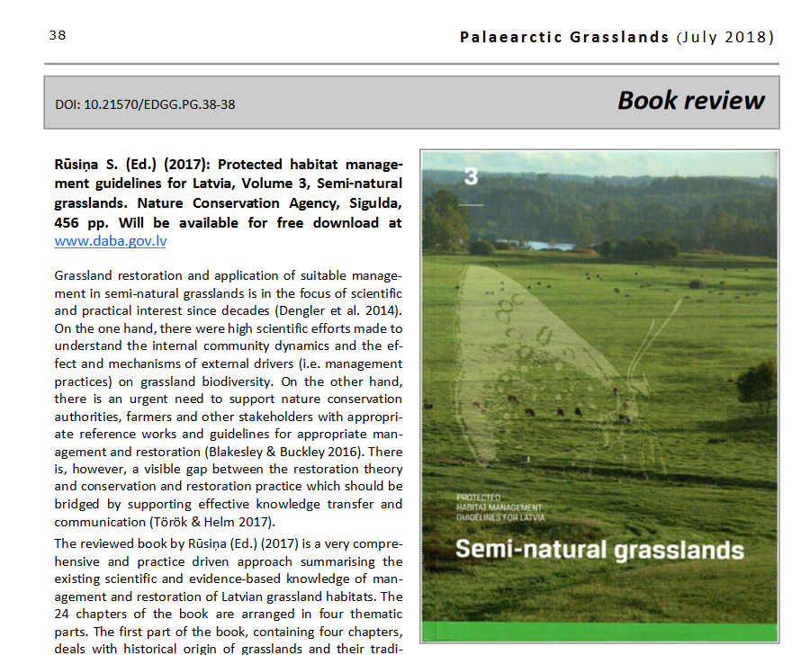
Personal assignment (homework)
1-2 weeks
Each participant receives a book with guidelines on the semi-natural grassland management in Latvia, and prepares a management plan for one of his/her grassland.
The plan can be submitted on paper (on a form handed out on Day 1) or digitally.
The book is available as pdfs:
http://nat-programme.daba.gov.lv/public/eng/documents_and_publications/

Slide 17
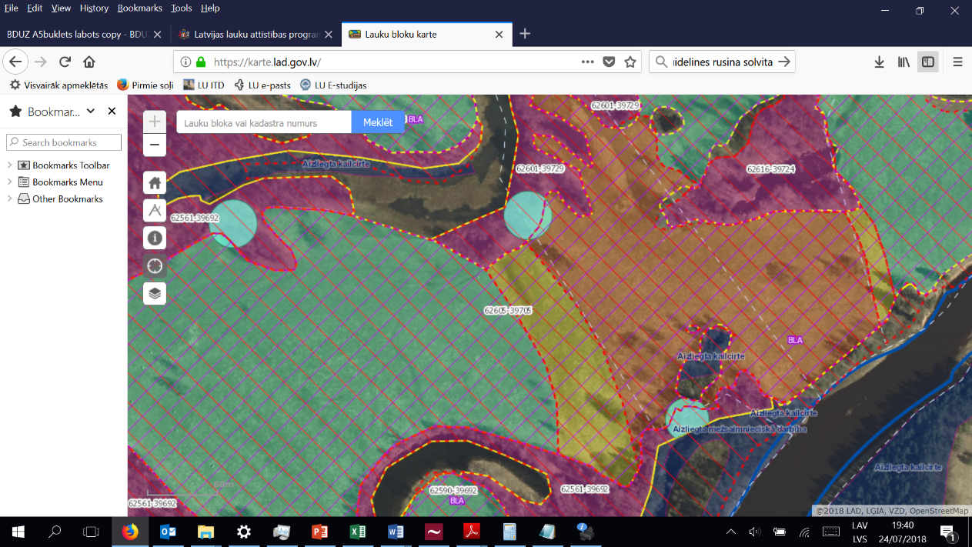
Example of a management plan
Grasslands eligible for MBG scheme as they appear in Rural Support Service homepage https:/karte.lad.gov.lv/

Slide 18
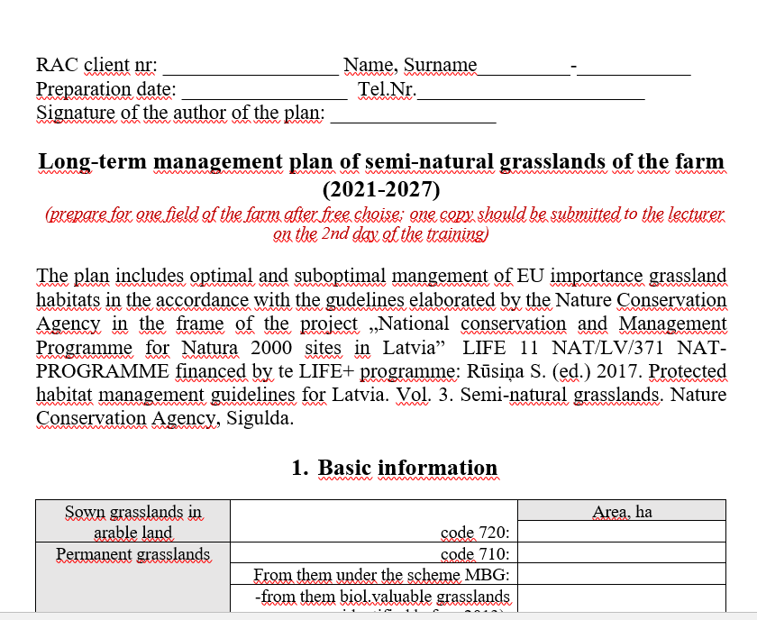
Form for a management plan -1

Slide 19
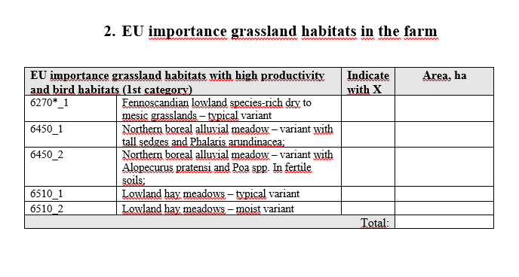
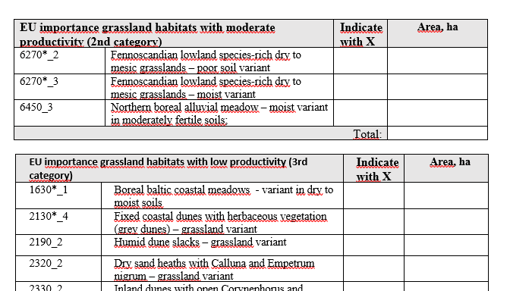
Form, cont. - 2

Slide 20
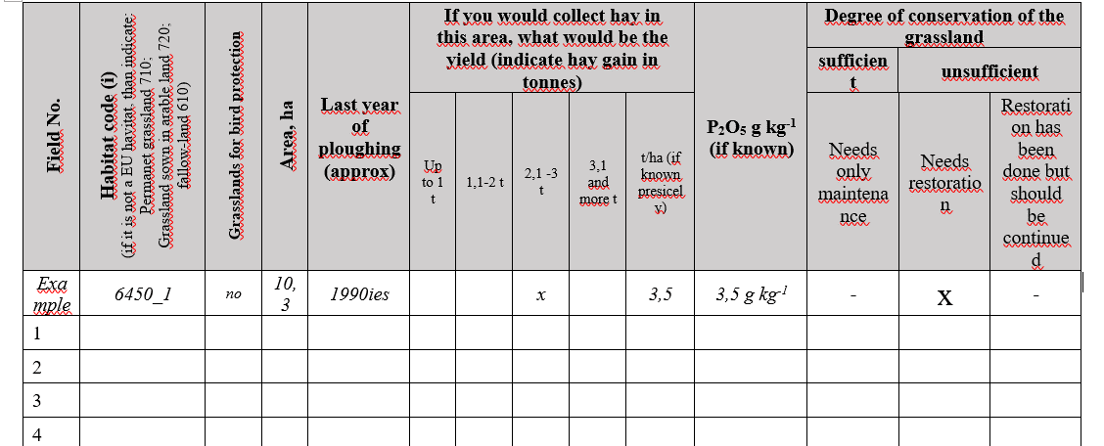
Form, cont. - 3

Slide 21
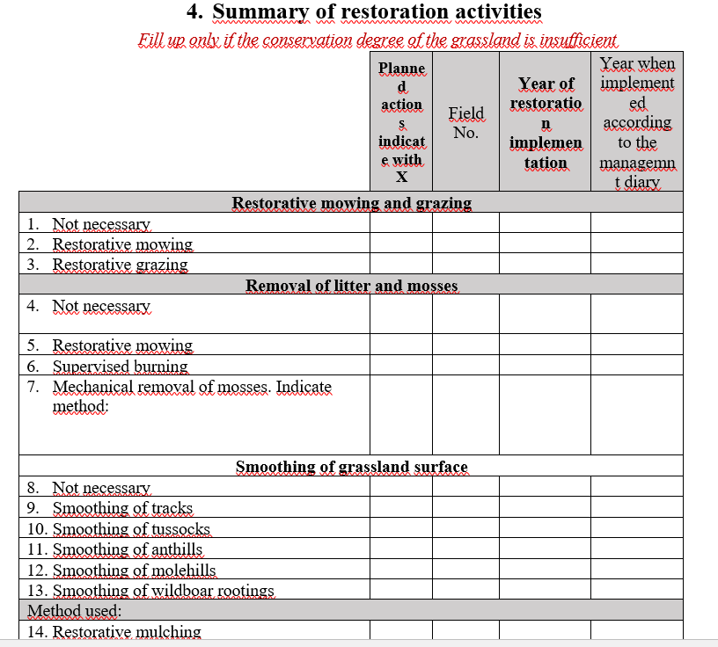
Form, cont. - 4

Slide 22
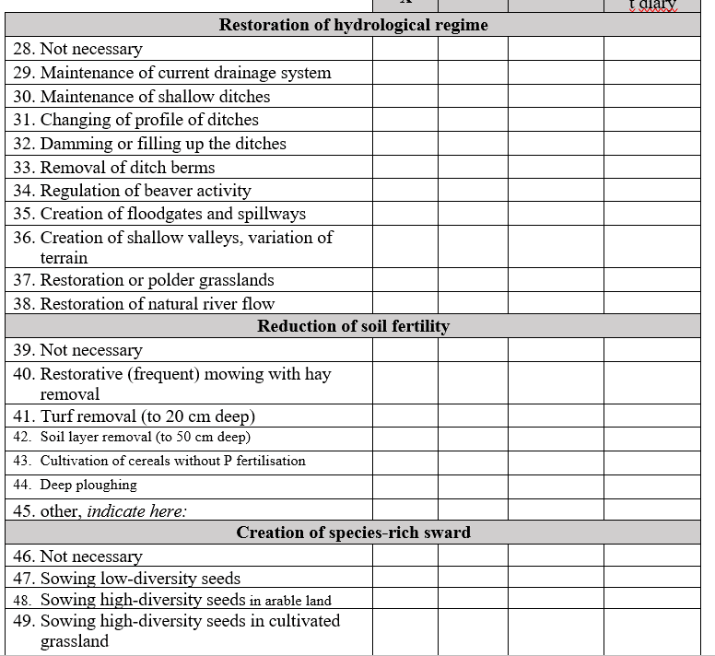
Form, cont. - 5

Slide 23
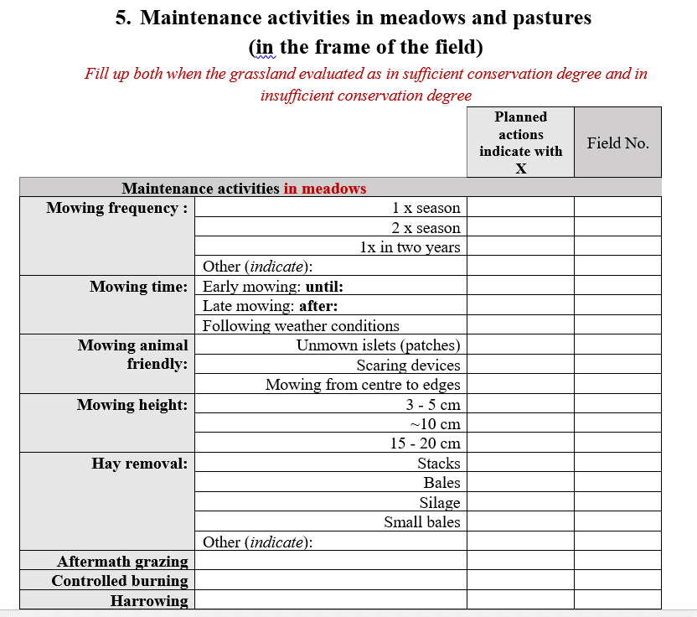
Form, cont. - 6

Slide 24
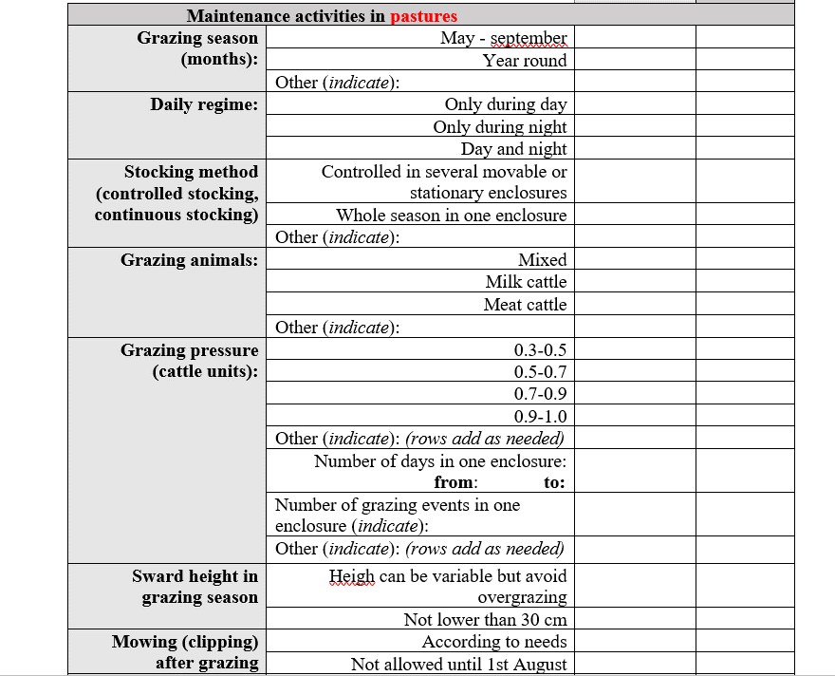
Form, cont. - 7

Slide 25
Day 2: Presentations
Given by the experts and short interactive activities on the themes (4 hours):
How habitat mapping is done, daily work of habitat experts
Best practices in habitat management, innovative solutions
The place of Latvian grasslands in the EU grassland biodiversity and conservation
Restoration of grassland habitats

Slide 26
Day 2: Discussions of homework
Format up to the lecturer, e.g. free discussion or work in groups
Example I: Presentation discussions
During presentations on best practices and on restoration, lecturer asks farmers to share their experiences in preparing management plans – what methods of management did they plan?
Example II: Small group discussion
Discussion of homework (40 min), group summary presentations (7min/group):
how did group participants decide whether restoration was needed;
What are the main restoration and management methods they planned;
What were the main problems in preparing management plan?
Notes:
discussion about homework (lecturer is free to organise the discussion as he/she feels it works the best – free discussion or work in groups).
Example I: during the presentation about the best practices in habitat management lecturer asks farmers to share their experiences in preparing management plans – what methods of management did they plan for their grasslands. The same discussion is organised during the presentation about restoration methods
Example II: participants work in small groups (4-5 people) for 40 min with the task to discuss their experience with homework and answer three questions: 1) how did they decide if the restoration activities were needed in their grassland; 2) what were the main restoration and management menthods they planned; 3) what where the main problems for them to prepare the management plan. 7 min for each group is given to present the results of group discussion

Slide 27
Day 2: Field day, 4 hours
Visit to grassland for which an owner/manager participant (owner/manager) has designed management plan (homework assignment).
Expert introduces main habitat types, shows dominant, typical and indicator species; participants name species they know and ask questions – 40 min.
Farmer explains site’s management history and current management – 20 min.
In groups of 4, participants complete management plan for the parcel – 60 min.
Participants use grassland map, management plan form, plant indicator species guide, and a short summary of theory.
Groups present their version of the plan - 40 min.
Site owner/manager presents his/her version of the plan - 20 min.
Discussion: experience exchange on practical issues relevant for site management, e.g. grazing approaches, animal welfare, machinery, grassland products - 40 min.
Notes:
Site owner/manager presents his/her version of the plan: preferably, an expert has assisted the farmer in preparation so that farmer gains confidence in hosting such as training event Discussions of the results, main problems and possible solutions

Slide 28
Content
Background to the the agri-environment scheme and training in it
Training content and methods
Results
Challenges and improvements

Slide 29
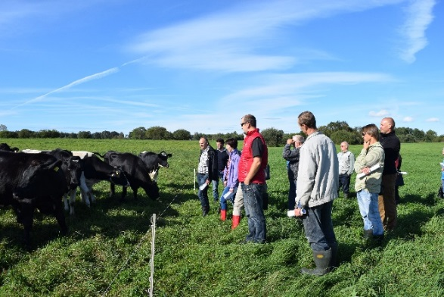
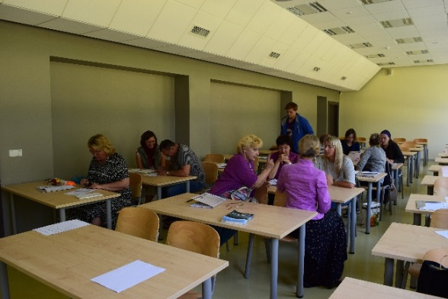
Results and feedback
More than 1500 farmers attended the training 2016-2018.
Results are based on the feedback in 2016 (Rūsiņa et al. 2016):
several open questions to the instructors (8 of 12 persons responded);
anonymous questionnaire to the farmers (500 responses from groups of 6 instructors)
Rūsiņa et al. 2016. Results of the training course «European Union's grassland habitats or species habitats» in 2016 and proposals for improvement of the course and for the development of a result-based agri-environment measure
Notes:
Source: Rūsiņa, S., Baroniņa, V., Lārmanis, V., Namatēva A., Sniedze-Kretalova, Rūta, Pošiva-Bunkovska, A., Silamiķele, I., Uzule, L. 2016. Mācību kursa “Eiropas Savienības nozīmes zālāju biotopu vai sugu dzīvotņu apsaimniekošana” rezultāti 2016. gadā un ierosinājumi kursa uzlabošanai un rezultātorientēta agrovides pasākuma izstrādei [Results of the training course «European Union's grassland habitats or species habitats» in 2016 and proposals for improvement of the course and for the development of a result-based agri-environment measure]. Latvijas Lauku konsultāciju un izglītības centrs, Latvijas Lauksaimniecības Universitāte, Rīga, 14 pp.

Slide 30
Learning outcomes: perspective of the experts
Semi-natural grassland management plan
30 % of the plans were well done with sufficient detail
70 % of the submitted management plans were incomplete:
30 % did not contain information about habitat type of their grassland)
Many management plans contained controversial information. e.g. ex-arable land in need of restoration lacked restoration actions in the plans.
Some participants asked for, but did not receive, advice from the advisors of the local office of the Latvian Rural Advisory and Training Centre.
Several participants recognised problems in their grassland but, in order to avoid potential penalties, did not propose management solutions
Notes:
70 % of the submitted management plans were incomplete, farmers did not manage to fill-in even basic data about their grasslands (habitat type, area etc.)
30 % of the plans did not contain information about habitat type of their grassland (even though the management guidelines are presented separately for each habitat type). Possible reasons are difficulties in aquiring information from the official website of Nature Conservaton Agency. The interface of the system many not be user-friendly (even though each instructor showed step by step usage of the website on Day 1 of the training)
Some participants asked for advice from the advisors of the local office of the Latvian Rural Advisory and Training Centre. However, they did not get proper help. These advisors did not participate in the same training.
Several participants admitted recognising problems in their grassland but they did not propose any management solutions to these problems in the management plan. This is necessary to avoid possible penalties from the Rural Advisory Service.
Many management plans contained controversial information. For instance, 60 % of the plans were planned for grasslands on ex-arable land (farmers indicated the last year of ploughing). In such grasslands, restoration activities such as sowing native plant seeds, reduction of fertility, eradication of expansive or invasive species are needed. However, some restoration activities were included in only 32 % of the plans.

Slide 31
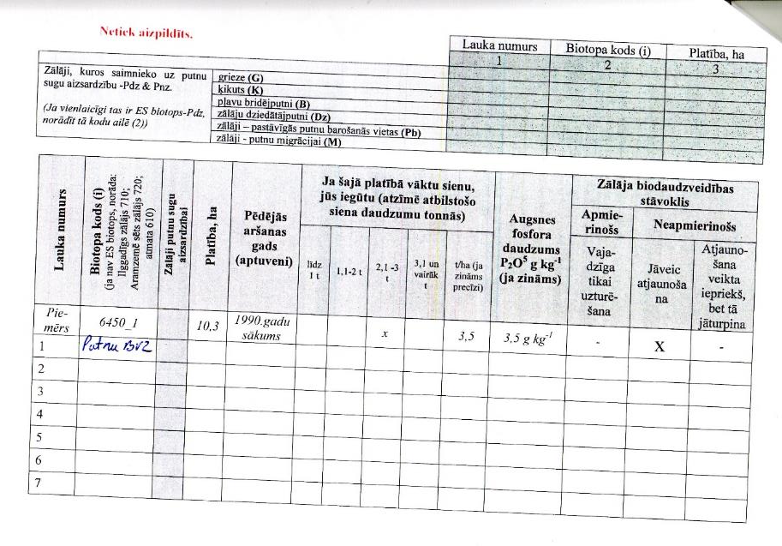
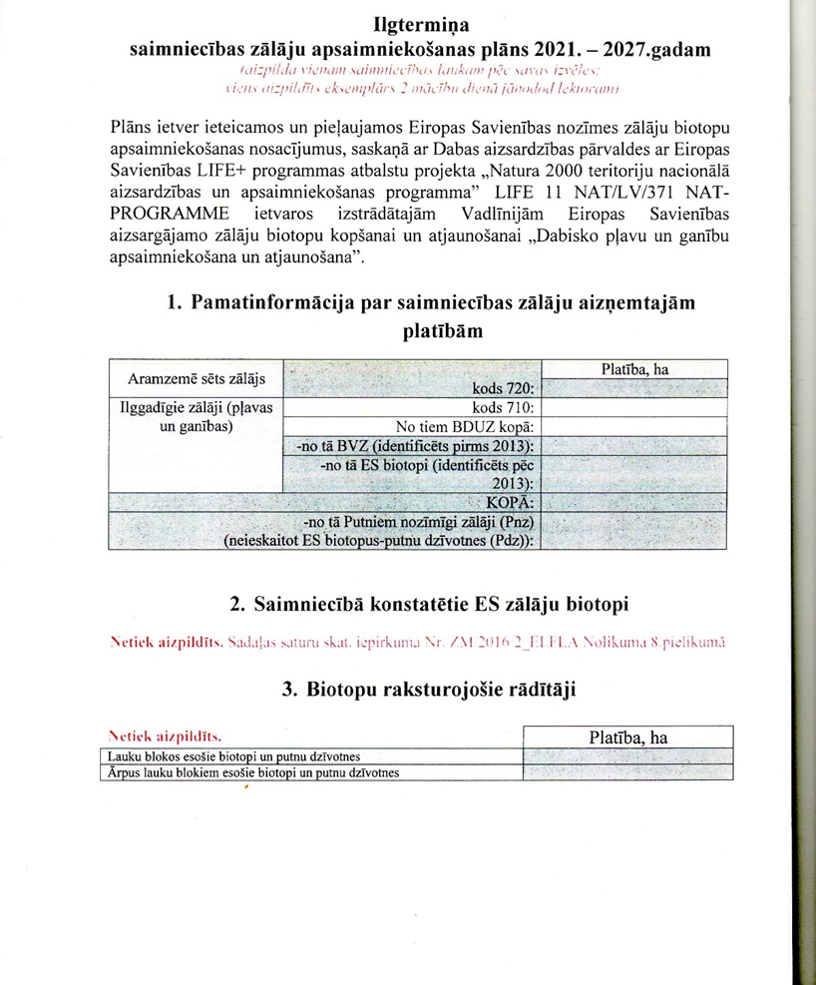
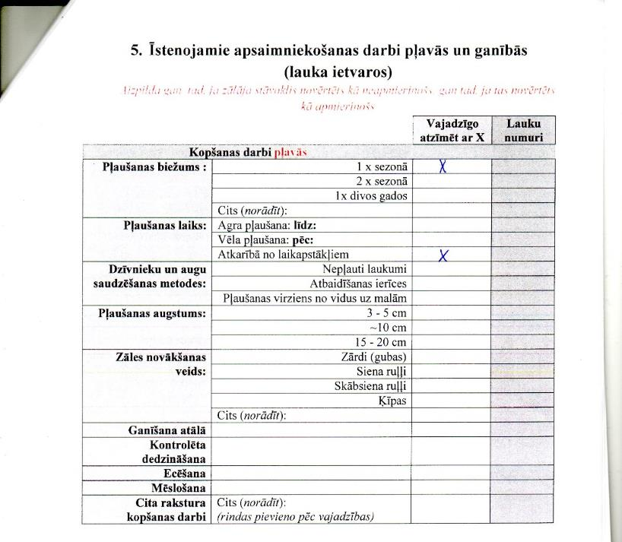
Submitted incomplete plans
Example of an incomplete plan. About 70 % plans were incomplete, farmers did not manage to fill-in even basic data about their grassland (habitat type, area etc.)

Slide 32
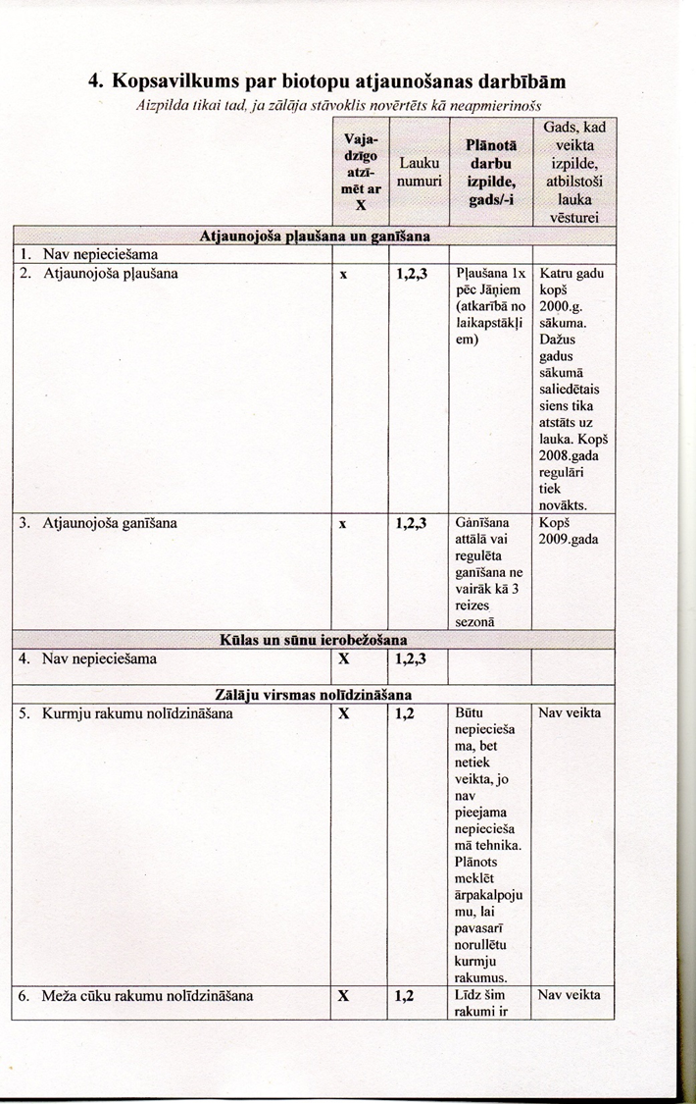
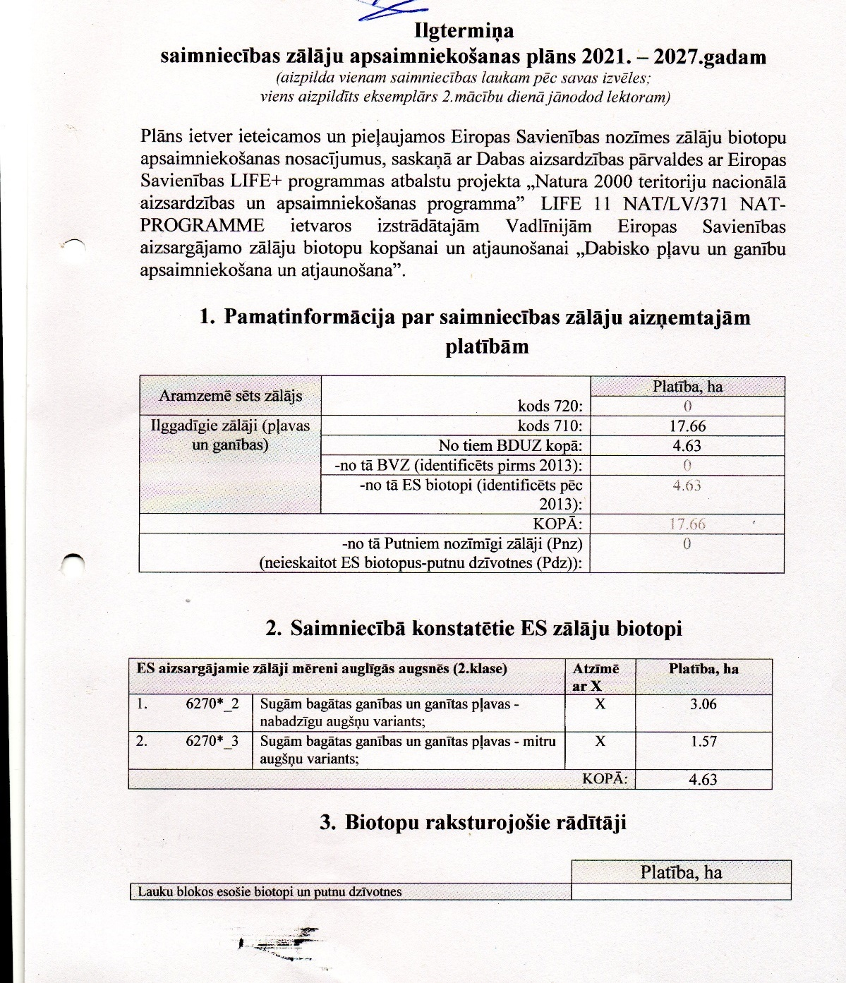
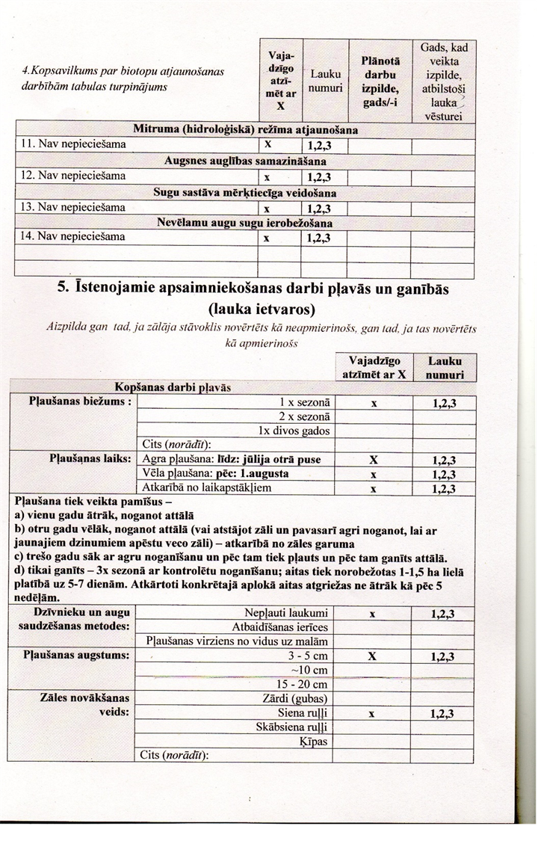
Example of a detailed plan. About 30 % plans were elaborated well and in detail
Submitted completed plans

Slide 33
Learning outcomes: perspective of the experts
2. Attitudes
Improved towards the scheme and semi-natural grasslands
Majority of participants were interested & participated;
Sceptics developed positive views toward scheme;
Knowledge developed, including for best practices.
Farmers are looking forward to the result-oriented approach
Several participants said that they had parcels with “all the right flowers”, need only to resume management.
Some are thinking of keeping their grasslands instead of ploughing them up.
One said he had “done the rules as Rural Support Service demanded” and “Where were you to tell me that I had done everything for all these 10 years to ruin the grassland?”
Prior to the training, most farmers had not thought about grassland as habitat for “insects, flowers and birds».
Each group had individuals who were not satisfied
Mainly due to having small parcel(s) with maintenance costs exceeding payment.
Notes:
2. Attitudes
Better attitude from farmers towards the scheme and semi-natural grasslands
Overall, the results of the training were very positive. The majority of participants were interested, participated in discussions and expressed their views, shared experiences. All instructors noted that many participants, who were initially very skeptical, changed their views during training. Many participants acknowledged that, after the training, their understanding of the semi-natural grassland management changed. For example, until then, many had thought that grinding (mulching) was beneficial for grassland because of improving soil fertility.
Farmers are looking forward to the result-oriented approach
Participants expressed an interest in restoring their abandoned and overgrown semi-natural grasslands. For example, several participants said that they had parcels with all the “right flowers” and they needed only to resume the management. Some participants considered the idea to keep their grasslands instead of ploughing them up. One farmer admitted in the conversation that he had “done the rules as Rural Support Service demanded” and “Where were you to tell me that I had done everything for all these 10 years to ruin the grassland?” Most farmers admitted that until then they had not thought about the grassland as a habitat for “insects, flowers and birds».
Some instructors noted that there were individual people in each group who were not satisfied about owning a semi-natural grassland, mostly in cases where a parcel was small and costs for maintaining it were higher than the payment.

Slide 34
Learning outcomes: perspective of the experts
3. Using the management plans submitted by training participants for the implementation and administration of a results-oriented agri-environment scheme
Inadequate training
Instructors estimate that training was inadequate for the farmer to acquire the competence needed for developing a management plan of good quality.
Inadequate knowledge
Farmers with production grasslands have better grasp of grassland ecological processes.
Farmers with only rented land & those managing it for subsidies had poor understanding.
Advisory services needed
In parallel to training, farmers need access to high quality advisory services, both in field by surveying grasslands together and during the development of the management plan.
Notes:
Using the management plans submitted by training participants for the implementation and administration of a result-oriented agri-environment scheme
The instructors estimated that farmers' knowledge of the semi-natural grasslands and their maintenance remained inadequate and the 16-hour training was too.
Mainly farmers whose grasslands were part of production (mainly, through grazing) had good understanding of the ecological processes in grasslands. Farmers who only rented their land or managed it for subsidies had poor understanding.
In conclusion, the training was inadequate for the farmer to acquire the competence needed for developing a management plan of good quality that would be suitable for the implementation of the result-oriented scheme.
In parallel to training, providing farmers high quality advice is necessary: both in field by surveying grasslands together and during the development of the management plan.

Slide 35
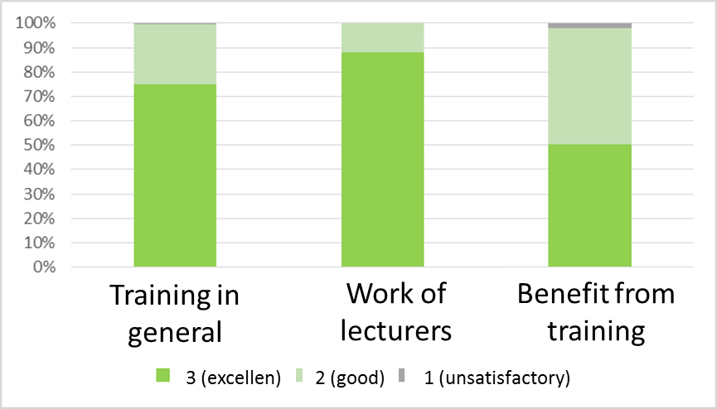
Feedback from the farmers
n = 416

Slide 36
Possible reasons for low scores about the benefits from the training
Timing
2016 training took place in late August-October
Most grasslands already mown or grazed, plant species not in flower
Poor prior knowledge
Participants little to no subject knowledge prior to training.
Training had no time for building basic knowledge to support development of the practical skills and competences from the theory.
No individual consultations
The instructors could not provide individual consultations.
Many questions of the participants related to their particular situations (financial, technical, physical conditions like soil, terrain, moisture etc.) and grassland condition remained unanswered.
Notes:
In 2016, the training was organised in late August-October by which the majority of grasslands had been mown or grazed and plant species were not flowering -> the field visits were not as productive as they would be in summer.
Participants had no or only weak knowledge about the subject before the training. There was no time to provide sufficient basic knowledge so that it supports practical skills. The amount of training was insufficient to build up practical skills and competences from the theory.
The instructors could not provide individual consultations. Many questions of the participants related to their particular situations (financial, technical, physical conditions like soil, terrain, moisture etc.) and grassland condition remained unanswered.

Slide 37
Content
Background to the the agri-environment scheme and training in it
Training content and methods
Results
Challenges and improvements

Slide 38
Challenges
Farmer-designed management plans without expert input insufficient for result-oriented scheme administration
Participants do not receive further assistance in designing their management plans
Exceptions: voluntary work of experts, lecturers
No funding to cover costs of visiting all grasslands for which the plans are being produced
Training focuses solely on public support (agri-environment scheme)
does not include other (market-based) possibilities from using semi-natural grasslands
Notes:
Management plans designed by farmers without assistance are not adequate for the result-oriented scheme administration
The participants do not receive further assistance in designing their management plans
in some cases, they can call an expert for advice (voluntary work of experts, lecturers)
There is no funding to cover costs of visiting all grasslands, for which the plans are being produced
Training focuses solely at the public support (agri-environment scheme) and does not include other (market-based) possibilities from using semi-natural grasslands.

Slide 39
Improvements: information & communication
Interface of the official web page of the habitat and species database in Latvian should be user-friendly, also for farmers
Accessible and understandable information for farmers about farm’s grasslands: i.e. conservation values & management needs. Versions of expert assessment need to be made that are understandable to farmers
An interactive website should be developed based on the above information.
Identification guides for grassland indicator species and problematic species in print are needed http://old.ldf.lv/upload_file/29124/DAP-Iepazisim_Plavas-DEMO.pdf is out of print and not available for farmers.
Notes:
The interface of the official web page of the habitat and species database in Latvian should be user-friendly, also for farmers
There should be accessible and understandable information about farm’s grasslands, their conservation values, and management and restoration needs. The grassland inventory forms (filled-in by habitat experts who inventoried the grasslands are available) should be translated into farmer’s language: using no scientific (Latin) names, explaining the causes of problems (e.g. expansive species, litter layer, mulching), illustrating indicator species.
An interactive website should be developed based on the above information.
Identification guides for grassland indicator species and problematic species should be developed and published (paper versions are easy to use in field conditions) in sufficient numbers; there is a field guide for the semi-natural grassland indicator species http://old.ldf.lv/upload_file/29124/DAP-Iepazisim_Plavas-DEMO.pdf but it is out of print and not available for farmers.

Slide 40
Improvements: training & funding
Training should include business issues
e.g. promoting grassland-based products, innovations.
Management plan structure should be more user-friendly
e.g. combine restoration & maintenance sections, add a land parcel map & field form for assessing grassland quality.
Training should include field visit by instructor to all the participants’ grasslands.
Early advisory work with farmers is crucial and needs to be funded.
Network of experienced farmers that can later provide peer-to-peer support.
Instructor training is also needed
Especially for agricultural production and grassland products and their facilitation.
Notes:
Training should also include applied or business issues, such as promoting grassland-based products, innovative solutions for management, producing niche products.
The structure of the management plan should be more user-friendly: for instance, combine the restoration and maintenance sections, add a land parcel map and a field form for assessing the grassland quality.
The training should ideaally include a field visit to all the participants’ grasslands by an instructor.
More funding for advisory work with farmers is crucial at the beginning to build up a network of experienced farmers that can later provide peer-to-peer support.
There should be training also for the instructors, especially in issues of agricultural production (sown grassland management, livestock raising, animal welfare etc.) and grassland products and their facilitation.

Slide 41
Improvements: advisory services
Aim to provide qualified advisory in the local offices of the Latvian Rural Advisory and Training Centre.
Advisors should be certified habitat experts with experience in grassland management and restoration.
Advisor’s tasks should include:
Assisting and advising on the preparation of the grassland management plans;
Advising during the whole period of the contract;
Controlling (incl. inspection in field) the success of the scheme in terms of ecological outputs.
Notes:
To provide qualified advisory in the local offices of the Latvian Rural Advisory and Training Centre.
Advisors should be certified habitat experts with experience in grassland management and restoration.
Advisor’s tasks should include:
Assisting and advising on the preparation of the grassland management plans,
Advising during the whole period of the contract,
Controlling (incl. physical control in the field) the success of the scheme in terms of ecological outputs.

Slide 42
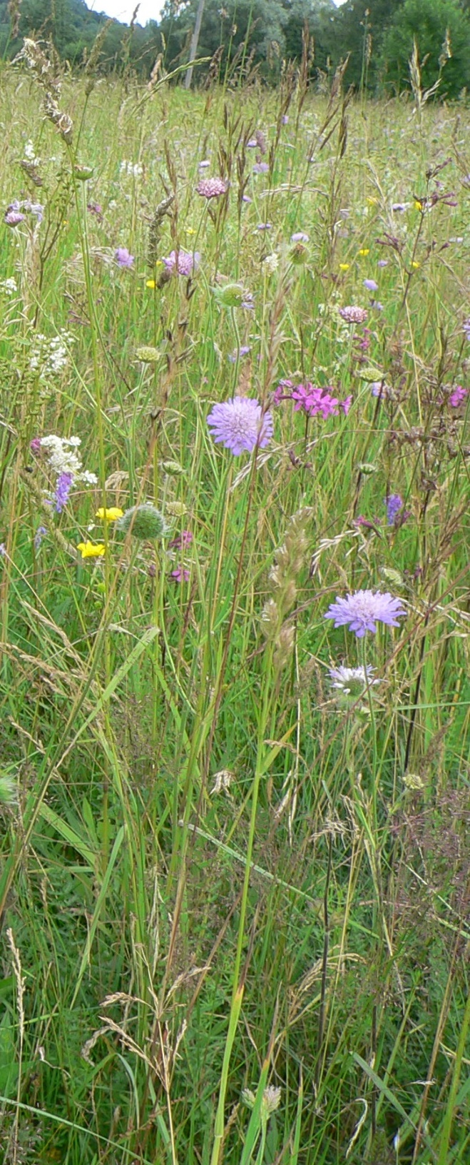
Thank you!

