Slide 1
Impact of abandonment on High Nature Value pastures of Sardinia
Emmanuele Farris
Dept. of Sciences for Nature and Environmental Resources
University of Sassari (Sardinia – Italy)
emfa@uniss.it

Slide 2
Notes for instructors and users
Emmanuele Farris (University of Sassari, Italy) provided this presentation to HNV-Link Project. The HNV-Link project team adapted it for inclusion in the educational package on High Nature Value farming. Notes are based partly on the information in the listed sources. Other resources of the education package are available www.hnvlink.eu
It is an Open Source material under CC BY-NC-SA. You may use freely any elements of it or as a whole, also modifying as fit, as long as you cite the project and its funding and use is for non-commercial purposes. Observe copyrights for images: unless otherwise specified, images are copyright by the authors.
THIS PROJECT HAS RECEIVED FUNDING FROM THE EUROPEAN UNION HORIZON 2020
RESEARCH AND INNOVATION PROGRAMME UNDER GRANT AGREEMENT NO. 696391
Notes:
Attribution-NonCommercial-ShareAlike CC BY-NC-SA https://creativecommons.org/licenses/
"This license lets others remix, tweak, and build upon your work non-commercially, and although their new works must also acknowledge you and be non-commercial, they don’t have to license their derivative works on the same terms."

Slide 3
Content
Introduction to Sardinia
Changes in land use and demography
Pasture types
Case-study: Abandonment of the hilly-montane sheep pastures and wooded pastures
Management, Conservation and Restoration

Slide 4
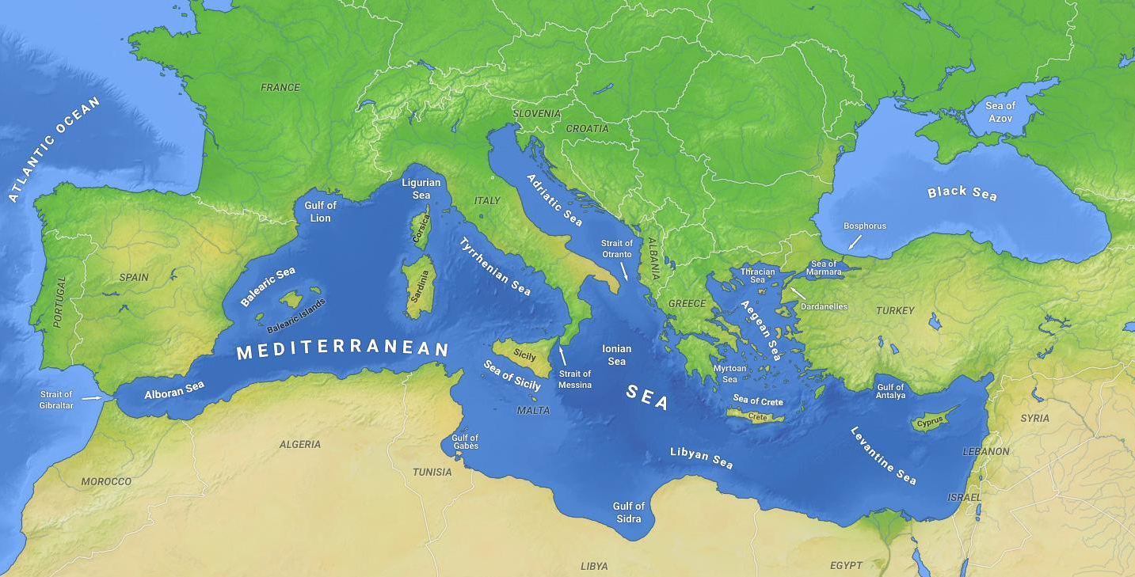
Sardinia
the second largest island in the entire Mediterranean sea
central part of the western Mediterranean Basin.
By O H 237 - Own work, CC BY-SA 4.0, https://commons.wikimedia.org/w/index.php?curid=38364150

Slide 5
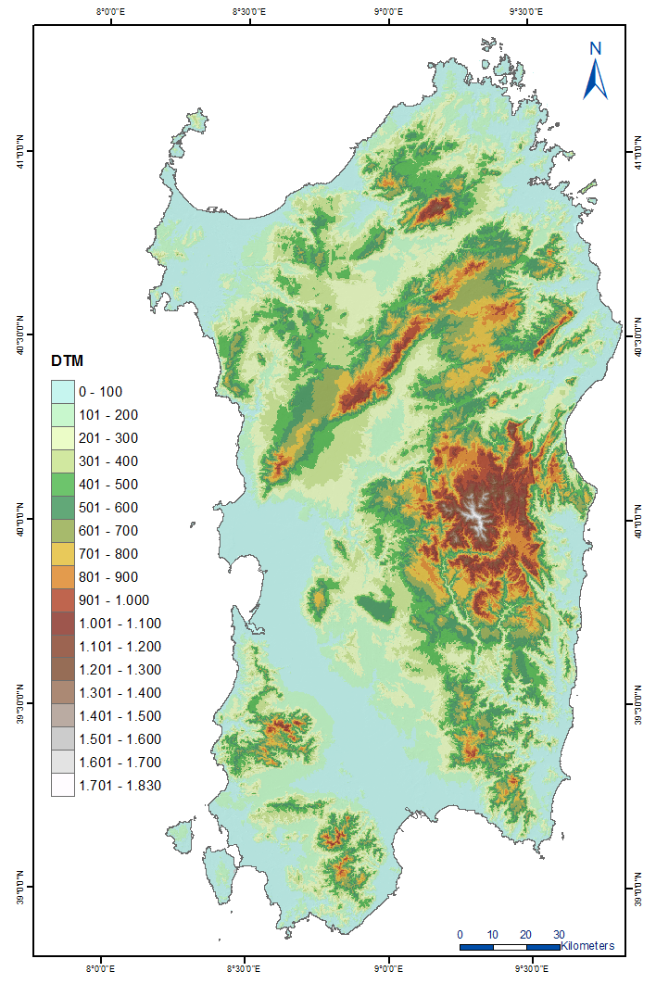
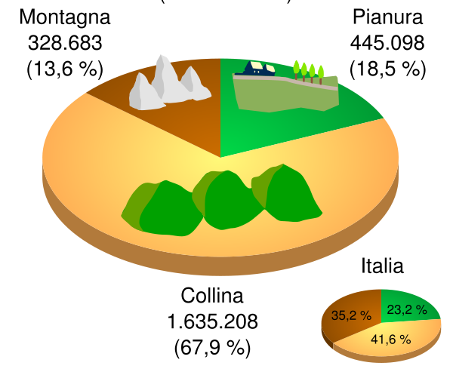
Surface: 24,090 Km²
Inhabitants: 1,672,422 (2008)
Density: 69.4 people/Km²
Sheep: ~5,000,000 (1990)
Highest mountain: Gennargentu (1832 m asl)
Mountains
Plains
Luigi Chiesa. Public domain. https://commons.wikimedia.org/wiki/File:Altimetria_Sardegna.svg
Zamonin - Source: one of the following Public Domain data sources ETOPO1 (Resolution 1° = 1,8km) GLOBE (Resolution 30' = 0,9km) SRTM (Resolution 3' = 90m). Description: Topography of Sardinia, created with GMT 4.1.3. CC BY-SA 3.0. https://commons.wikimedia.org/wiki/File:Sardinia_topo.png
Hills

Slide 6
Human history
Ancient civilization of “Nuragic” people (5,000-200 B.C.
Phoenicians (1500-235 B.C.)
Romans (235 B.C. – 496 A.C.)
Vandals (496–550 A.C.)
Bizantins (550–800 A.C.)
Independent Middle Age states (800-1410 A.C. )
Catalans – Aragons – Spanish (1354-1720 A.C.)
Piedimont Savoia (1720-1861 A.C.)
Italy (1861 A.C.-today)
People lived mainly on the coasts
Arabian attacks forced people to move to interior areas
People moved again to the coasts

Slide 7
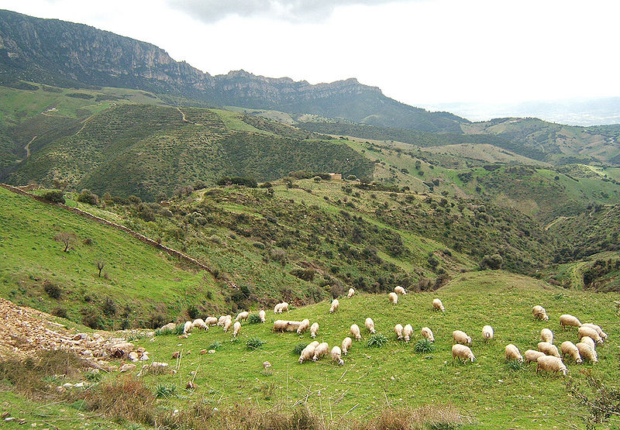
Modern economy
Shepherding in the interior areas, tourism on the coasts
Sheep grazing around Lula, Nuoro.
By Rafael Brix. CC-BY-SA-3.0 https://commons.wikimedia.org/wiki/File:Sheep_near_lula_sardinia.jpg

Slide 8
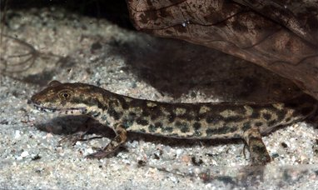
Biodiversity
Estimated 2 500 vascular plant species: a floristic density of 103.5 species/1000 km² - higher than the average of the Mediterranean Basin (10.8 species/1000 km² -> a biodiversity hot-spot (Médail & Quézel 1999).
Plants: 347 species endemic to the island (14.4% of all plant species), of which 155 species are exclusive endemics (sensu stricto, 6.2%).
Examples of endemic animals: Sardinian brook salamander, Bedriaga's rock lizard, four endemic subspecies of birds.
By Franco Andreone. CC BY-SA 2.5. https://commons.wikimedia.org/wiki/File:Euproctus_platycephalus01.jpg
Notes:
The Mediterranean Basin is one of the world's major centers for plant diversity, where 10% of the world's higher plants can be found in an area representing only 1.6% of the Earth's surface. For example, all of tropical Africa has the same plant richness (30,000 taxa) as the circum-Mediterranean region in a surface area four times larger.
Source: Médail, F. & Quézel, P. 1999. Biodiversity Hotspots in the Mediterranean Basin: Setting Global Conservation Priorities. Conservation Biology 13, DOI:10.1046/j.1523-1739.1999.98467.x

Slide 9
Content
Introduction to Sardinia
Changes in land use and demography
Pasture types
Case-study: Abandonment of the hilly-montane sheep pastures and wooded pastures
Management, Conservation and Restoration

Slide 10
The regional context (southern Europe / Mediterranean)
In the last century people moved from south to north and from mountains to the coast
In mountain areas
In coastal areas
Abandonment of agro-pastoral activities
Increasing of urbanization and mass tourism
Decreasing of pastures
Increasing of forests
Declining of dune vegetation
Increasing of protection on cliffs
Based on Falcucci, A., Maiorano, L., Boitani, L. 2007. Changes in land-use/land-cover patterns in Italy and their implications for biodiversity conservation. Landscape Ecology, 22: 617-631

Slide 11
Content
Introduction to Sardinia
Changes in land use and demography
Pasture types
Case-study: Abandonment of the hilly-montane sheep pastures and wooded pastures
Management, Conservation and Restoration

Slide 12
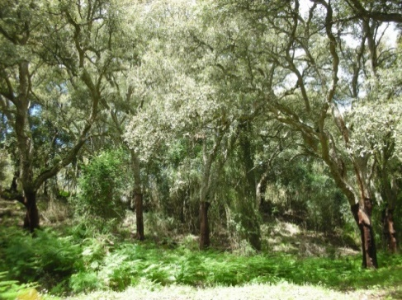
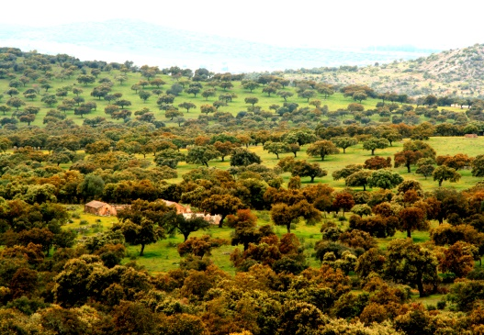
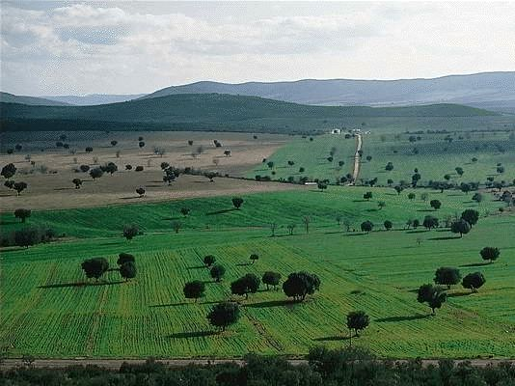
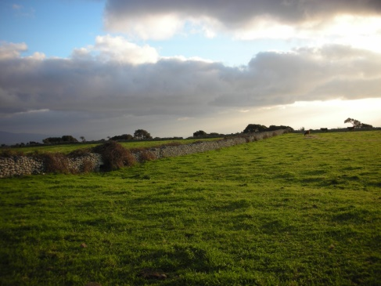
Pasture types in the Mediterranean:
Grazed woodlands
Dehesas
Wooded pastures
Open pastures
Coastal pastures

Slide 13
Grazed woodland – Cork Oak (Quercus suber)
Notes:
High density of trees, small cover of herbacious vegetation. Grazing density is low.

Slide 14
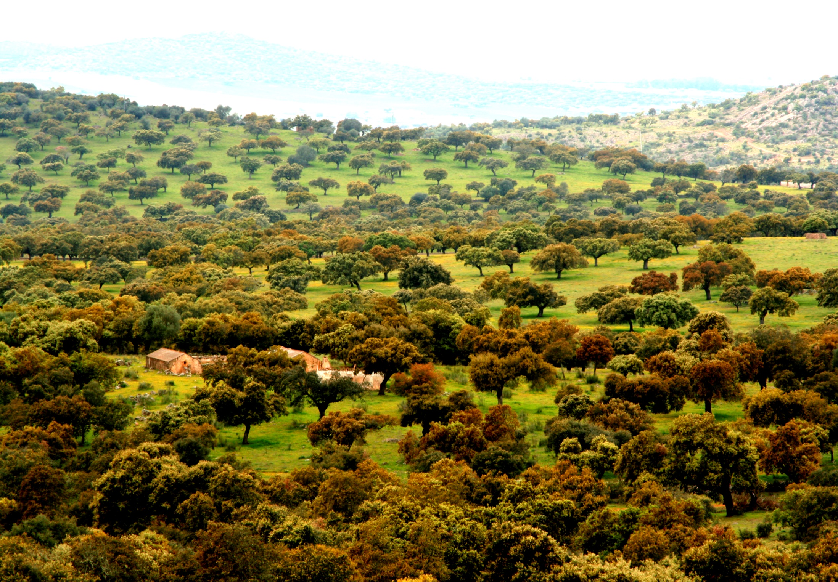
Dehesa – Cork Oak (Quercus suber)
AGFORWARD project. www.agforward.eu
Notes:
The Spanish dehesa constitutes an open woodland agroecosystem created and maintained by humans and their livestock. It is known example of multifunctional agroforestry systems
For more about dehesa see the case of “ The dehesa agroforestry system in the Iberian Peninsula” in HNV-Link educational package (www.hnvlink.fi/education)

Slide 15
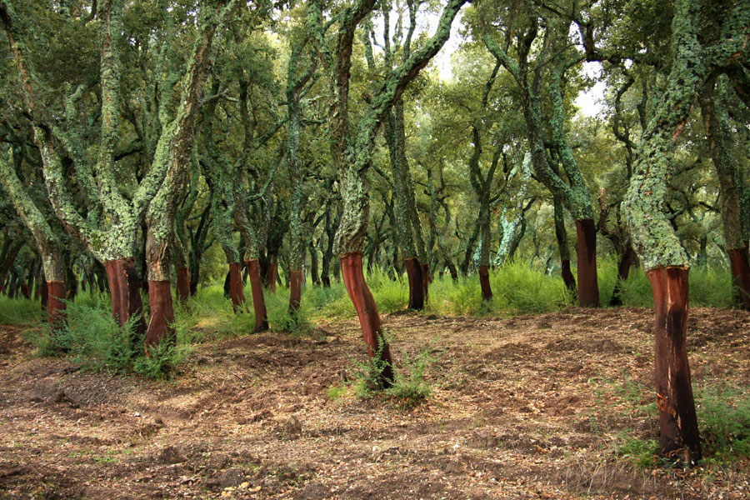
Wooded pasture – Cork Oak (Quercus suber)
Public domain. https://commons.wikimedia.org/wiki/File:Dehesa_cabaneros.jpg
By Alessandro Vecchi. CC BY-SA 3.0. https://commons.wikimedia.org/wiki/File:Sughero_TempioPausania.jpg

Slide 16
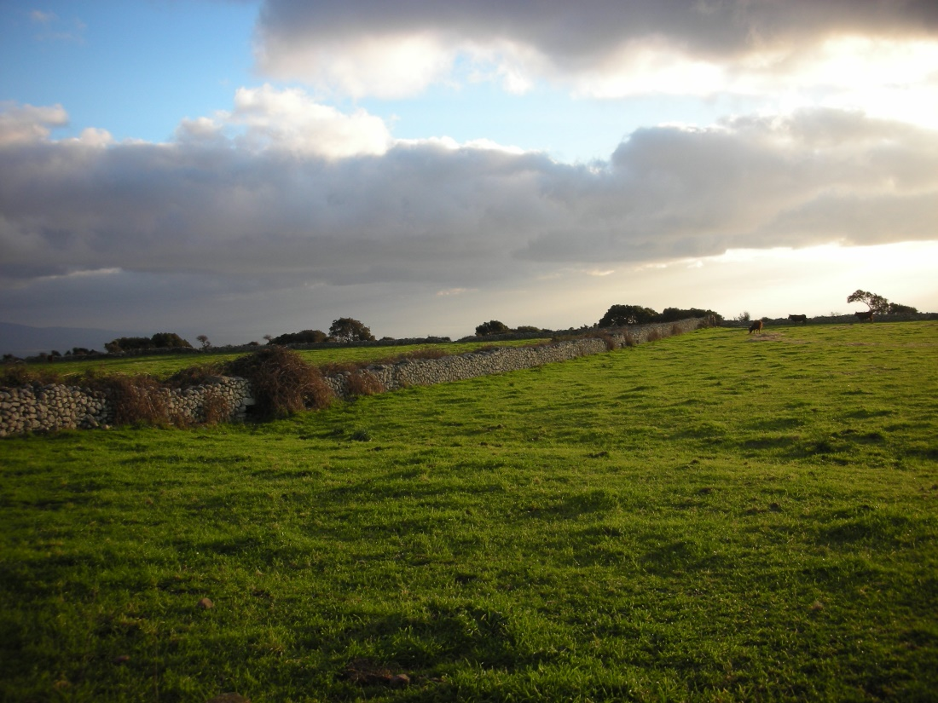
Open pasture

Slide 17
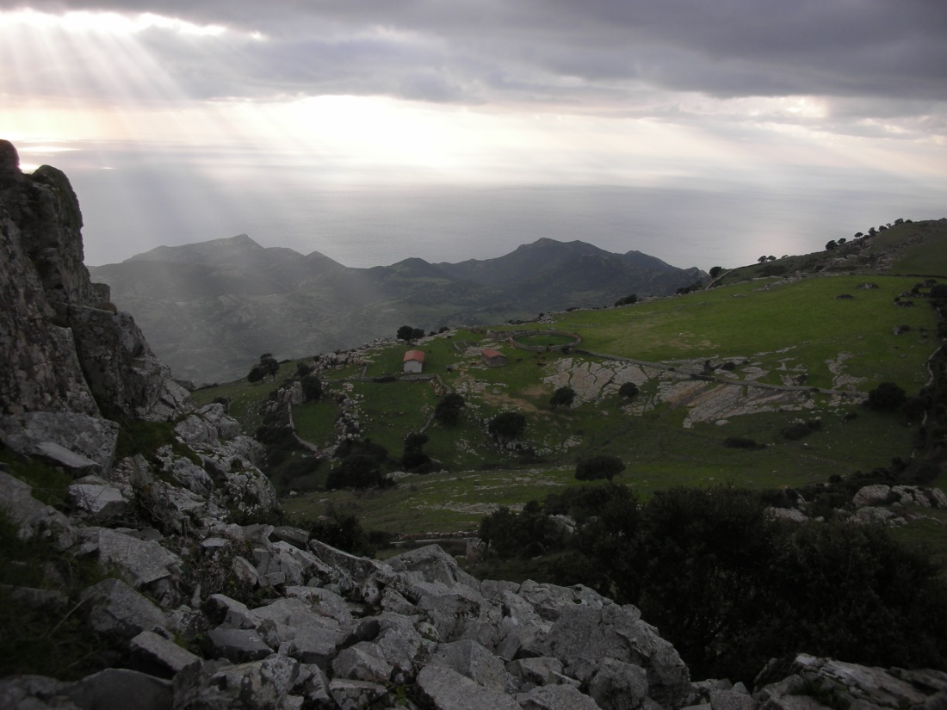
Coastal pasture

Slide 18
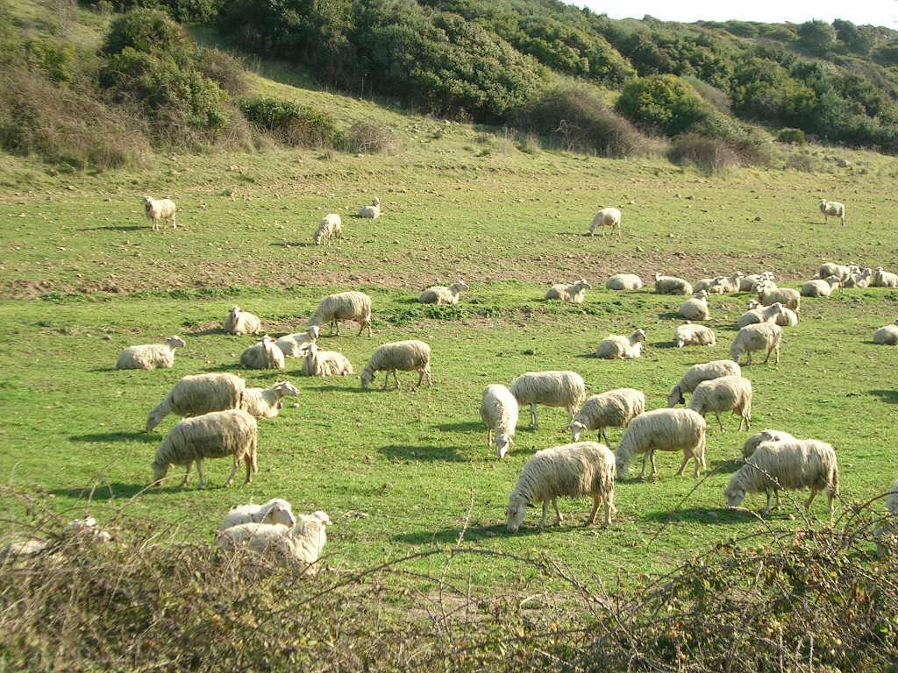
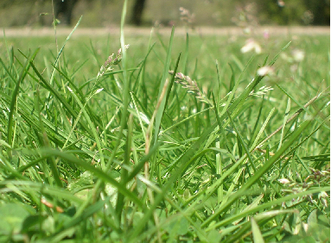
The pasture communities are often dominated by Poa bulbosa, a small perennial grass with clonal reproduction, well adapted to sheep grazing in the dry climate of the Mediterranean basin.

Slide 19
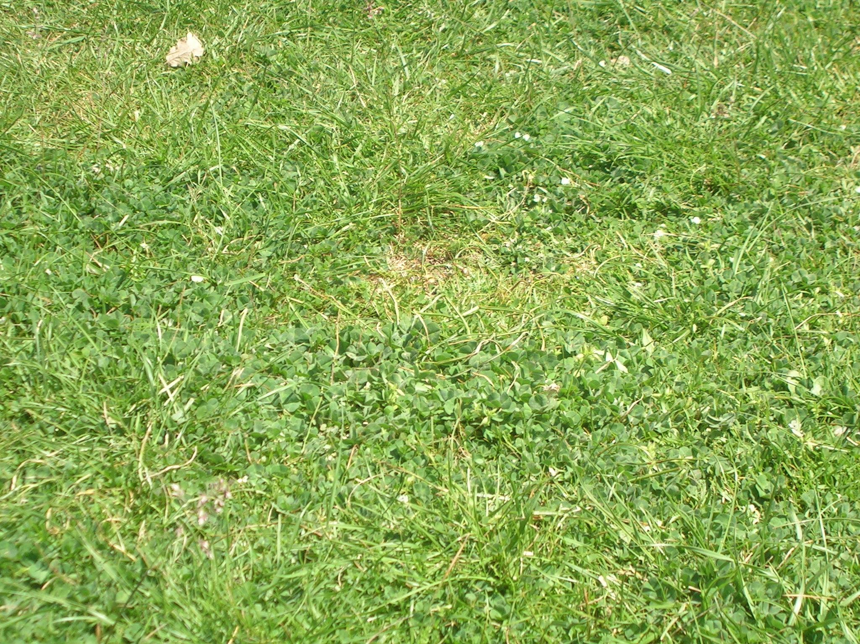
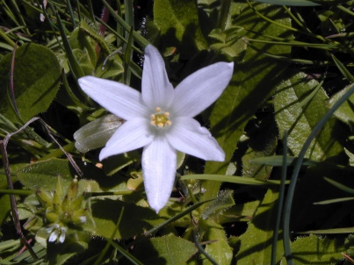
Ornithogalum corsicum
Notes:
Ornithogalum corsicum - endemic species of Sardinia and Corsica

Slide 20
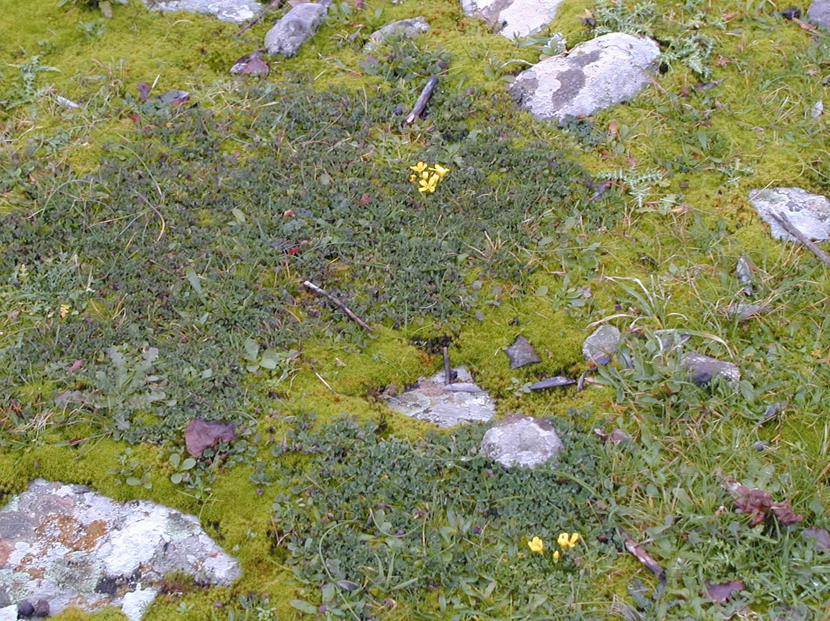
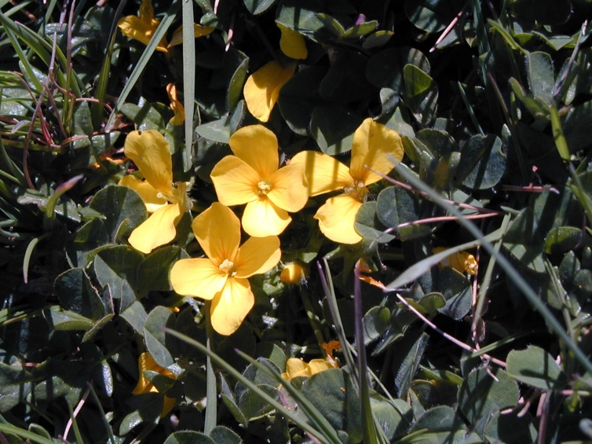
Morisia monanthos
Notes:
Species native to the Mediterranean islands of Corsica and Sardinia

Slide 21
Content
Introduction to Sardinia
Changes in land use and demography
Pasture types
Case-study: Abandonment of the hilly-montane sheep pastures and wooded pastures
Management, Conservation and Restoration

Slide 22
Abandonment
Severe negative effects on biodiversity and landscapes due to abandonment of traditional/extensive production systems - High Nature Value farming systems - in certain areas of particular conservation value (Peco et al. 2005; 2006).
28 out of 198 (14%) listed habitat types of the EU Habitat Directive (European Commission, 1992) - threatened due to the cessation of traditional low-intensity agricultural practices (Ostermann, 1998).
Notes:
Peco B., de Pablos I., Traba J. & Levassor C., 2005. The effect of grazing abandonment on species composition and functional traits: the case of dehesa grasslands. Basic and Applied Ecology 6: 175-183.
Peco B., Sánchez A.M. & Azcárate F.M., 2006. Abandonment in grazing systems: consequences for vegetation and soil. Agriculture, Ecosystems and Environment 113: 284-294.
Ostermann O.P., 1998. The need for management of nature conservation sites designated under Natura 2000. Journal of Applied Ecology 35: 968-973.

Slide 23
Western Mediterranean plant communities are adapted to the continuous treading and fertilization of sheep stock
Composed of small-sized therophytes, geophytes, and hemicriptophytes, included in the phytosociological class of Poetea bulbosae
Are characterized by high species richness
Recognized as a major habitat for biodiversity conservation within the EU,
Designated as 6220*- Pseudo-steppe with grasses and annuals of the Thero-Brachypodietea in the EU Habitat Directive 43/92/EEC.

Slide 24
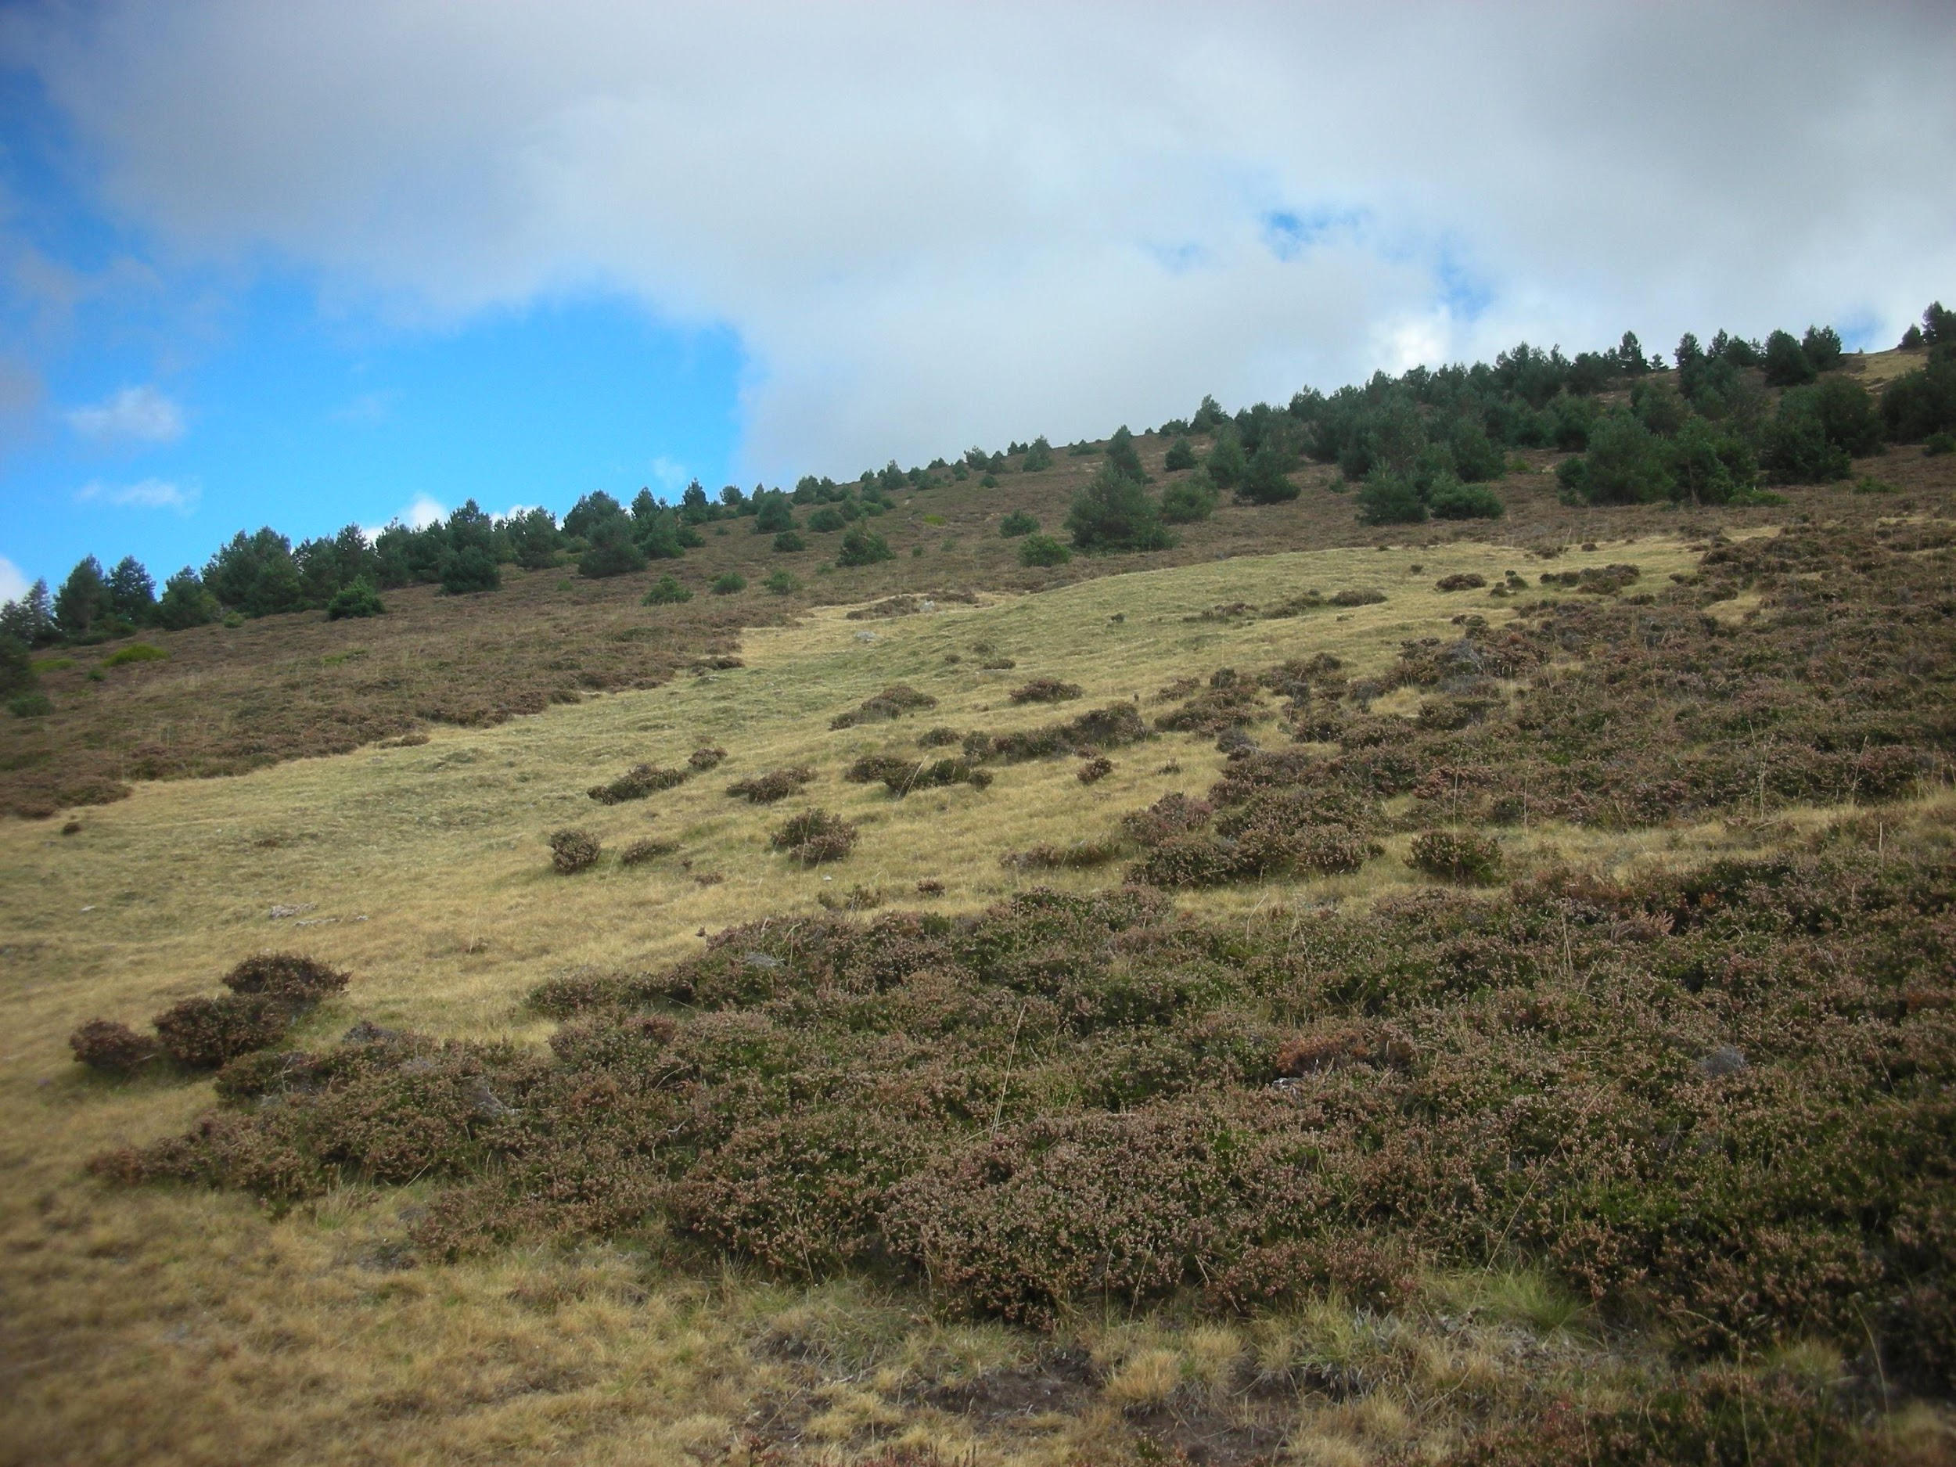
Example of a spontaneous afforestation of a pasture following its abandonment
Pinus sylvestris wood
Calluna vulgaris dwarf vegetation
Festuca indigesta pasture
Notes:
Continuous use of such pastures largely depended on a practice called transhumance - example here comes from Spain.

Slide 25
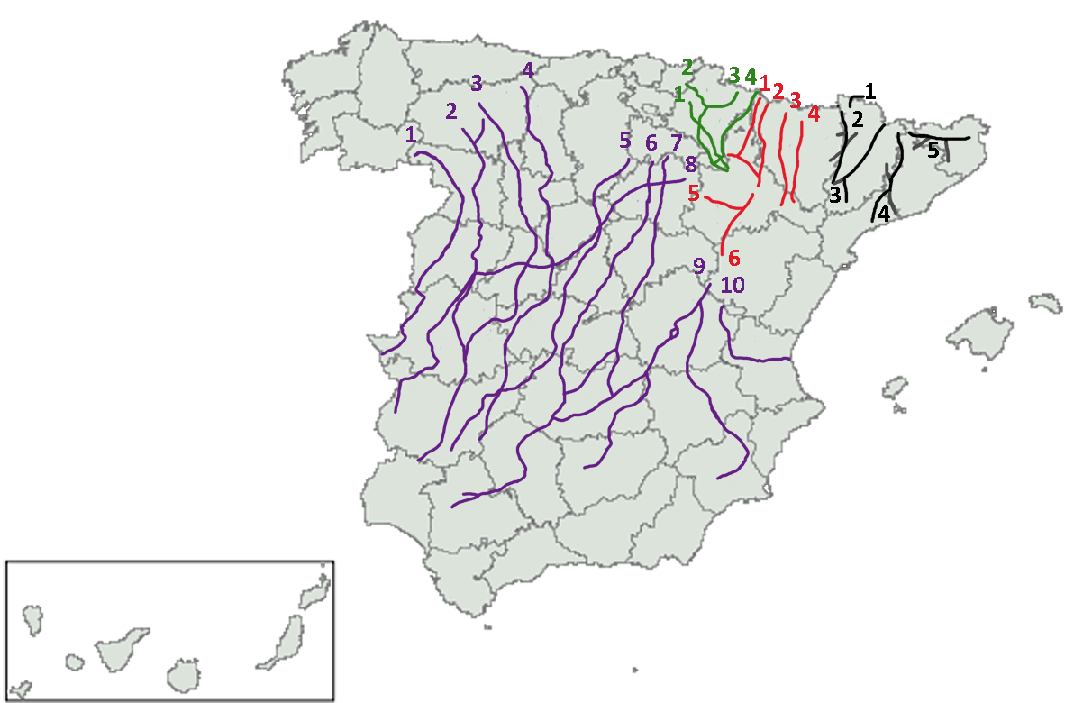
Socio-ecological system:
transhumance
Example: main Transhumance routes in Spain
By Diotime [Public domain], via Wikimedia Commons. https://commons.wikimedia.org/wiki/File:Principales_vias_pecuarias.png
Notes:
Transhumance = moving livestock from one grazing ground to another following a seasonal cycle. It used to be a wide-scale regional phenomenon across much of Mediterranean and in mountains. It supported use of poorly pastures productive only part of the year as well as maintained seed movements and recolonisation processes of species
See an example in https://vimeo.com/231845586

Slide 26
Impact of abandonment on
long-term scale >10 yrs (Kahmen et al., 2002; Peco et al., 2005, 2006) and
short-term (<10 yrs) scale (Jacquemyn et al., 2003; Marriott et al., 2002).

Slide 27
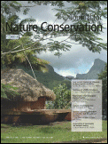
Farris E., Filigheddu R., Deiana P., Farris G.A., Garau G., 2010. Short-term effects on sheep pastureland due to grazing abandonment in a Western Mediterranean island ecosystem: a multidisciplinary approach. Journal for Nature Conservation 18: 258-267.
We aimed to highlight the consequences of abandonment on:
plant community composition (species number, individual density, life-forms and distribution categories ratio, and community height) and α-diversity,
soil fertility,
composition of microbial community
Notes:
An example of such studies

Slide 28
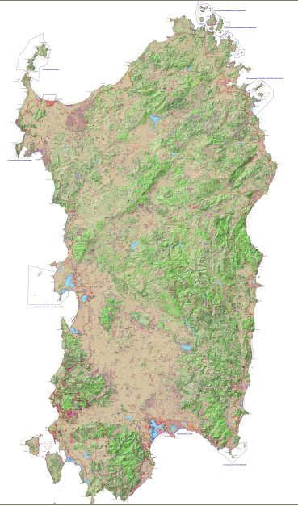
Study site
Average of 0.41 sheep ha-1 in 1990 - 2007.
A decrease of 83 %, from 0.77 sheep ha-1 (1990) to 0.13 sheep ha-1 (2007).

Slide 29
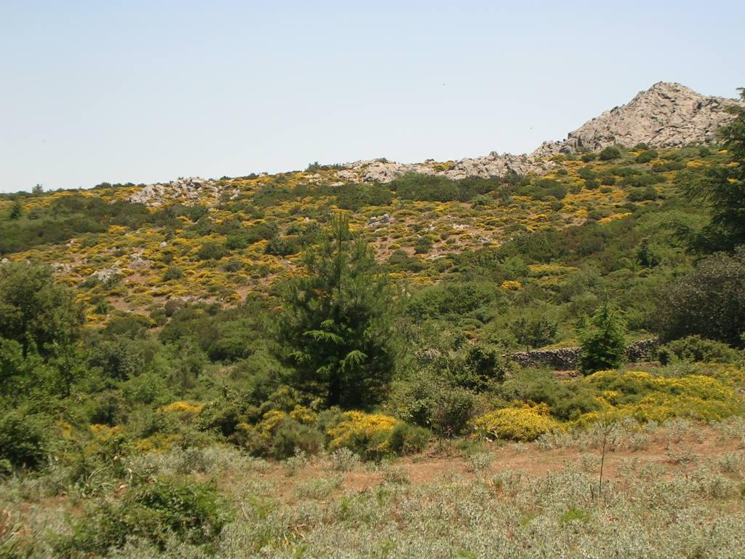
Vegetation dynamics
Genista desoleana dwarf vegetation
Quercus ilex wood
Genista desoleana dwarf vegetation
Poa bulbosa pasture

Slide 30
Experiment
- in July 2000, grazing excluded
- during 2000 – 2005, 10 fenced 10 x 10 m randomly located permanent plots grazed on average by 0.23 sheep ha-1
Monitoring:
June 2000, before the fencing (sampling time A),
June 2002 (sampling time B),
July 2005 (sampling time C).

Slide 31
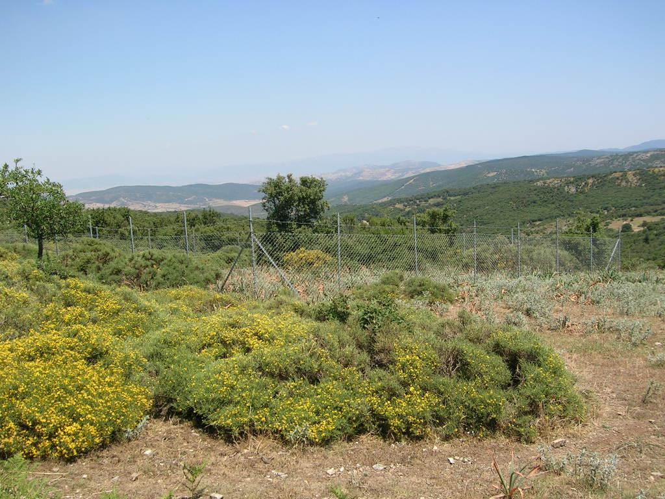
A 10 x 10 m fenced plot, summer

Slide 32
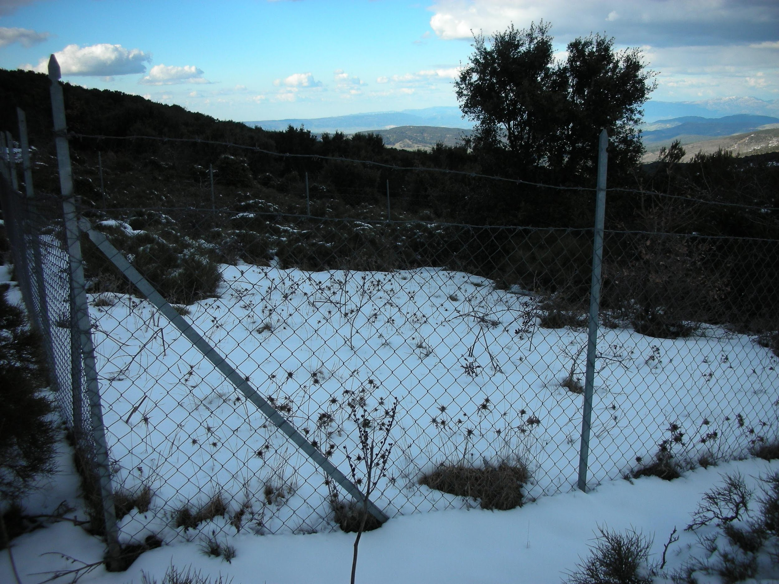
… and winter

Slide 33
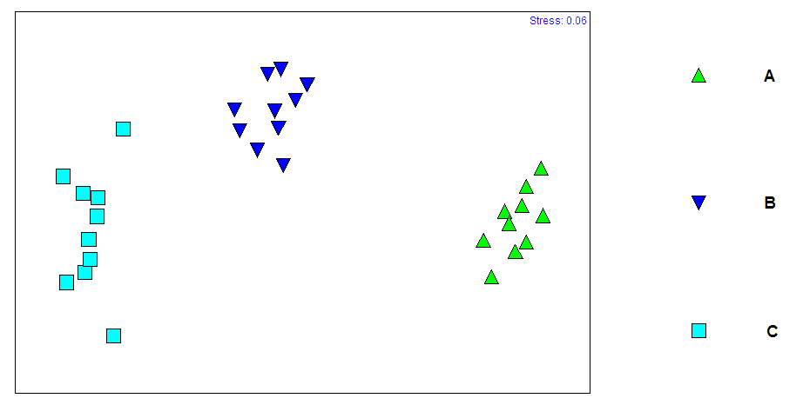
Results 1.
sampling time A: 2000, grazed
sampling time B: 2002, not grazed for 2 years
R = 0.982; P < 0.001
sampling time C: 2005, not grazed for 5 years
Distinct plant species assemblages among three sampling times: the longer the abandonment, the more different from the initial
Notes:
Analysis: Two-dimensional non-metric multidimensional scaling ordination (nMDS) of individual replicates (10 x 10 cm swards) comparing plant species assemblages among three sampling times in the fenced plots (▲, sampling time A: year 2000, grazed; ▼, sampling time B: year 2002, not grazed for 2 years; ■, sampling time C: year 2005, not grazed for 5 years).

Slide 34
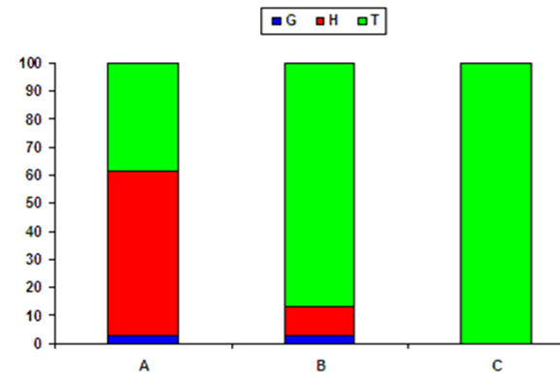
Results 2.
Perennials (H + G) dominant
Annuals (T) dominant
Only annuals remain
Density of geophyte spp: A = B > C, of therophyte spp: A < B < C
Therophytes - the best correlation to land-use change with time.
Notes:
Perennials (H + G) dominated at sampling time A, while annuals (T) dominated at sampling times B and C. Moreover, perennials completely disappeared during sampling time C. Significant differences were detected in geophyte and therophyte density at the different sampling times (P < 0.05). The geophyte and therophyte density was in the order A = B > C and A < B < C, respectively (SNK test, P < 0.05). Therophytes showed the best correlation to land-use change with time.

Slide 35
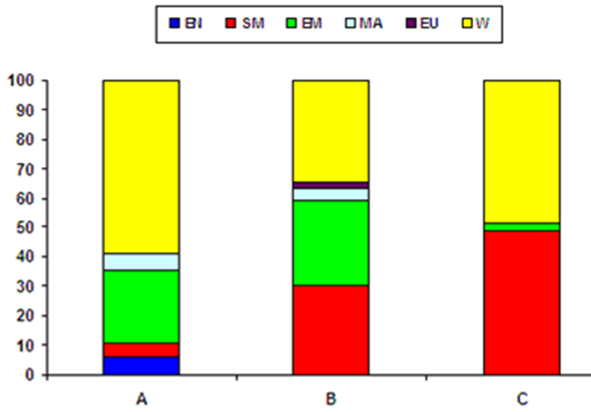
Results 3.
Covers of endemic, Eurimediterranean and Mediterranean-Atlantic species decreased or they disappeared,
Covers of stenomediterranean species and species with wide distribution increased.
Notes:
Endemic, eurimediterranean, and Mediterranean-Atlantic species decreased or disappeared with grazing abandonment, while stenomediterranean species and species with wide distribution increased (Fig. b). According to the SNK test (P < 0.05), the eurimediterranean and Mediterranean-Atlantic species density was A = B > C and A = B > C, respectively.

Slide 36
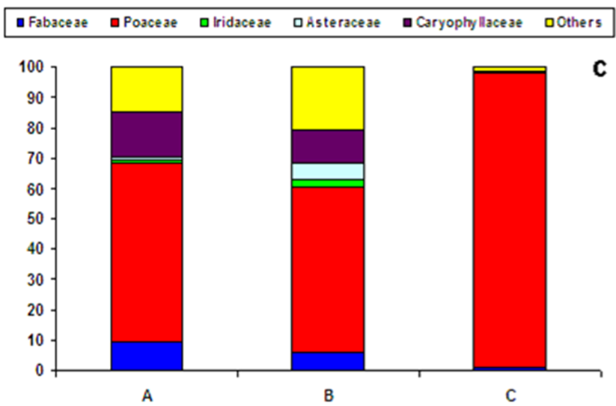
Results 3: changes in the most abundant families
Overall decrease in taxonomic diversity
Notes:
The most abundant plant families were Fabaceae, Poaceae, Iridaceae, Asteraceae, and Caryophyllaceae (Fig. c). Fabaceae and Caryophyllaceae decreased during different sampling times A to C, while Poaceae increased with land-use change. Iridaceae and Asteraceae increased in sampling time B. The SNK tests showed the densities of Asteraceae to be A = C < B, Caryophyllaceae C < B < A, Fabaceae C < B = A, Iridaceae C < A = B, and Poaceae B < A < C.

Slide 37
With grazing abandonment:
Individual species density increased (min at B),
Species density and α-diversity decreased from A to C, reaching max at B,
Vegetation height increased constantly,
Soil pH progressively increased,
Organic matter decreased,
Nitrogen decreased from A to C, reaching max at B,
The number of ammonia-oxidizing bacteria was low at all the sampling times, but increased
The population size of cellulolytic microorganisms was similar at B and C (~1.5*103 MPN g-1 soil) and was at min at A.

Slide 38
Lessons learnt
1) Livestock has a key role in maintaining the EU priority habitat 6220*.
The changes in the structure and the composition of pastureland communities can occur within a few years of abandonment.
Implications
Monitoring and maintaining of the pastoral management should be performed also at short terms.
Notes:
1) Livestock has a key role in maintaining the EU priority habitat 6220* and the detrimental changes to floral composition that pastureland communities may undergo due to short-term abandonment;
Remarkably, the results from this study revealed that changes in the structure and the composition of pastureland communities can occur rapidly following abandonment. Consequently, all the activities of monitoring and conserving the biodiversity and of maintaining the agricultural-shepherding status quo should be performed on an adequate time scale

Slide 39
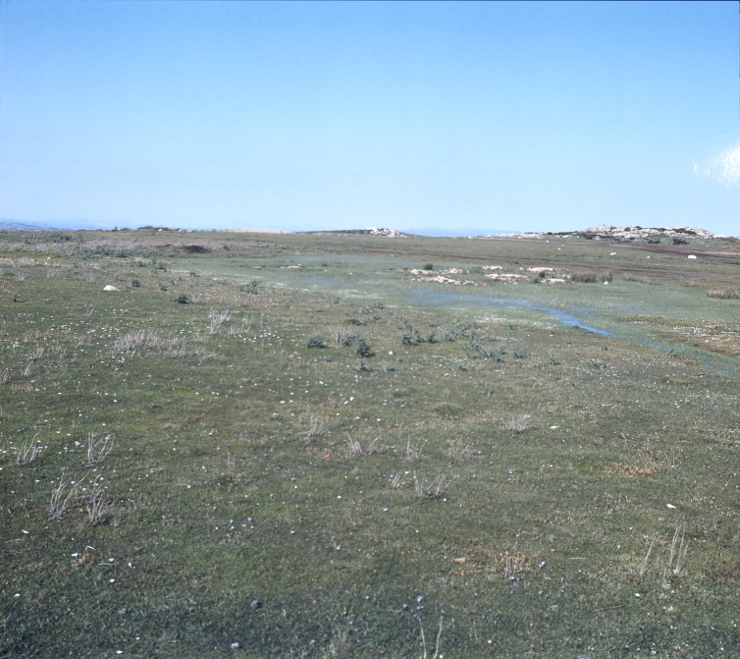
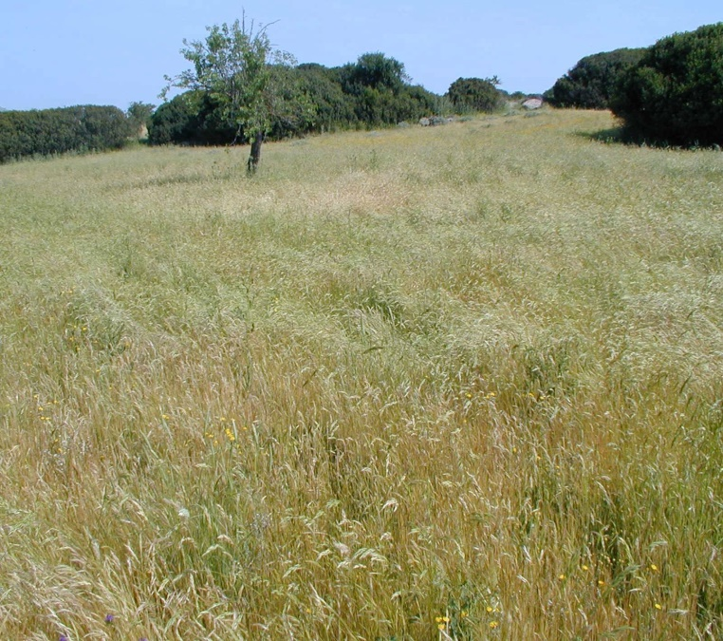
Studying, monitoring and managing at adequate time scales
Just 5 years
Habitat 6220*
No Directive habitat ☹

Slide 40
Content
Introduction to Sardinia
Changes in land use and demography
Pasture types
Case-study: Abandonment of the hilly-montane sheep pastures and wooded pastures
Management, Conservation and Restoration

Slide 41
Management, conservation and restoration
Secondary succession routes
Habitats, landscape
Species
Acting on socio-ecological systems
Acting on specific needs

Slide 42
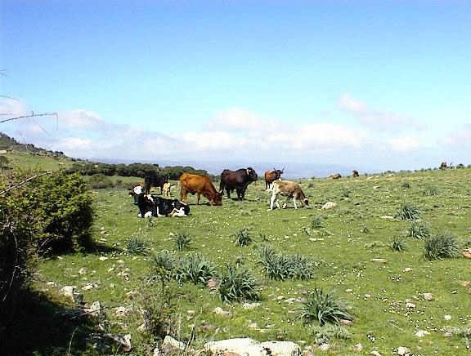
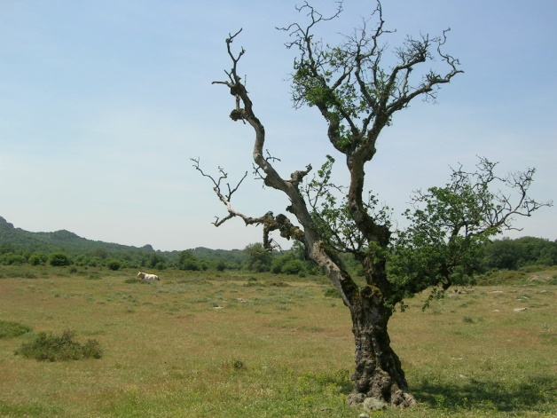
Dynamic two-way process
Grazed woodland
Wooded pastureland
Open pastureland
Reason: tree dye-off and lack of recruitment

Slide 43
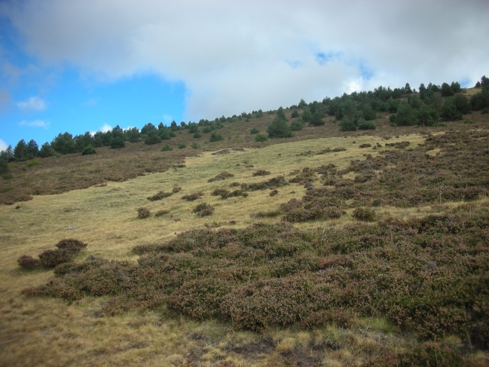
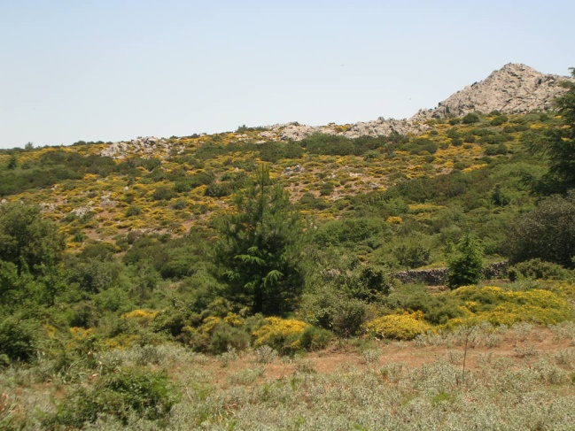
Dynamic two-way process
Grazed woodland
Wooded pastureland
Open pastureland
Reason: encroachment of trees

Slide 44
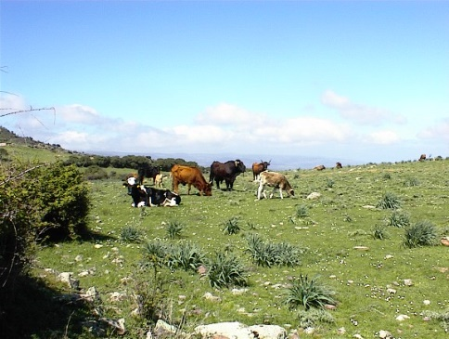
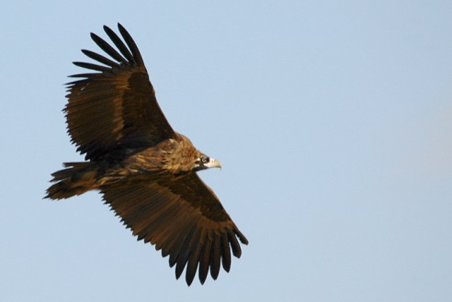
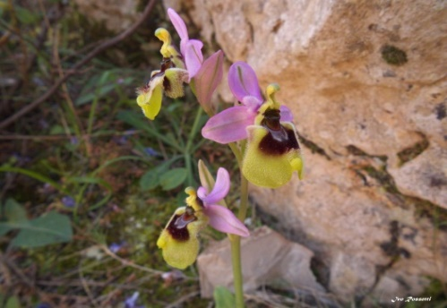
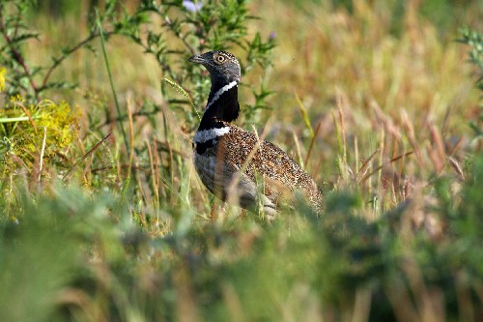
Different priority species – different needs
Grazed woodland
Wooded pastureland
Open pastureland
Black Vulture (Aegypius monachus)
Mediterranean orchids (Ophrys, Orchis, Serapias)
The Little Bustard (Tetrax tetrax)
Notes:
The Black Vulture (Aegypius monachus) nests on trees. It is not a forest bird, so it needs dehesas for nesting, and dehesas and/or open pasturelands for feeding
Mediterranean orchids (Ophrys, Orchis, Serapias) are not forest plants, but they need open areas. However, they suffer trampling and intensive grazing, so they need intermediate habitats as secondary meadows with low intensity grazing
The Little Bustard (Tetrax tetrax) needs open areas, so its density is negatively affected by the presence of trees and shrubs. It is also sensitive to the size of the herb habitat, and the management regime

Slide 45
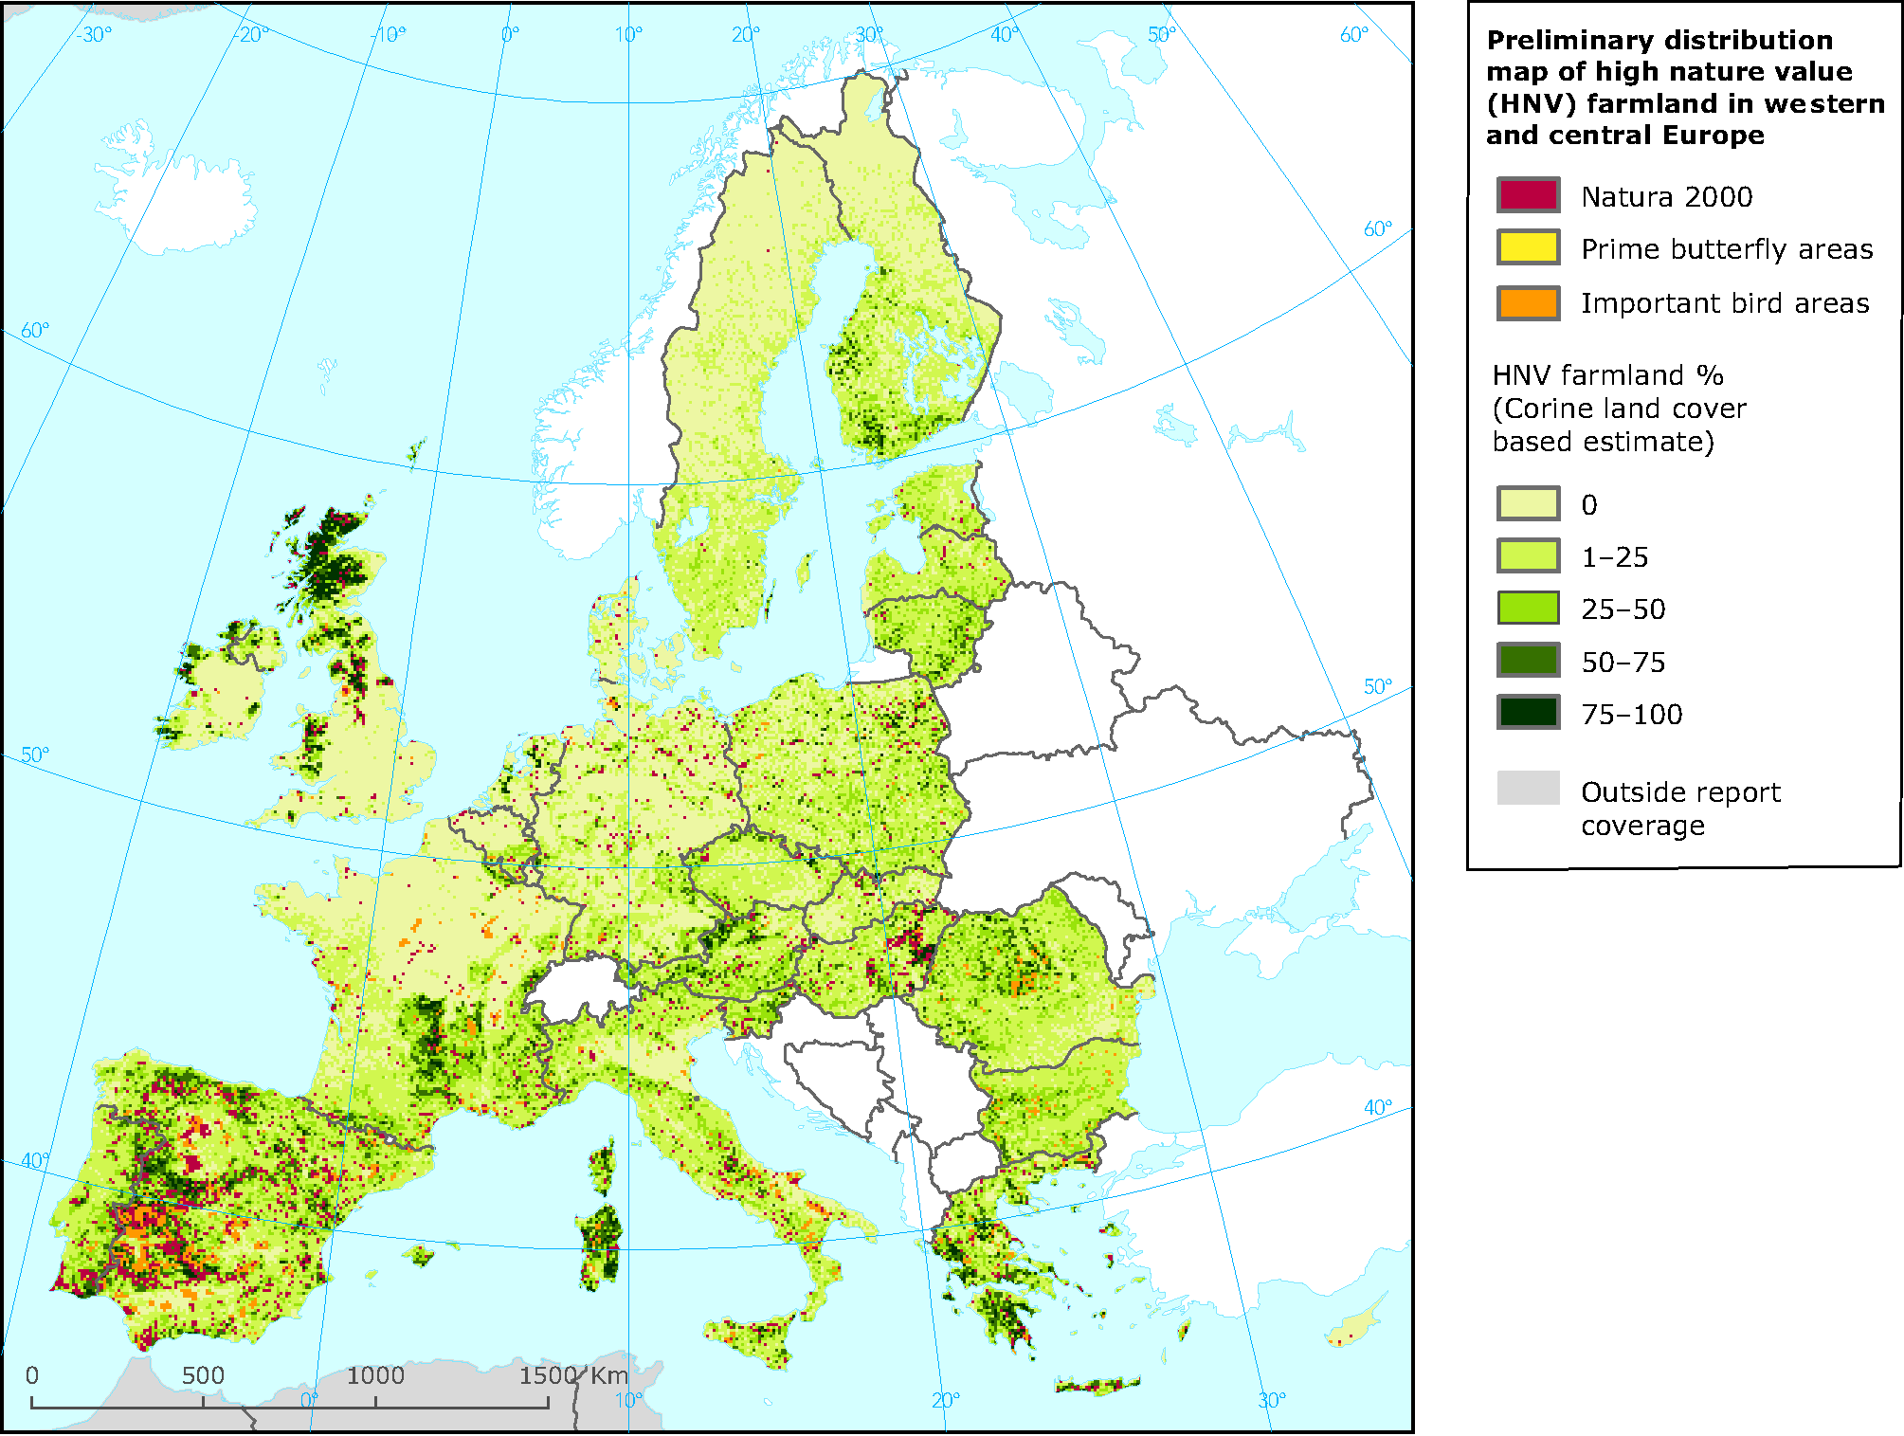
Notes:
A situation in Sardinia reflects that of many other HNV farmland areas but specific impacts of abandonment or other land use changes may vary across the regions

Slide 46
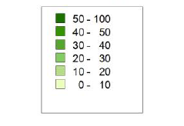
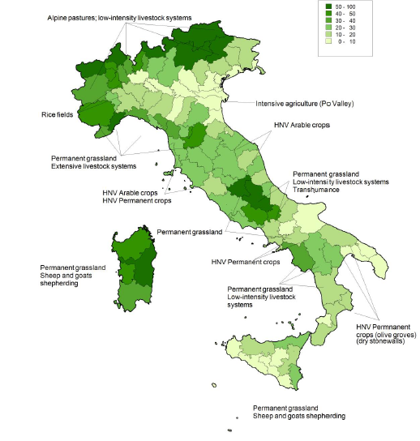
% HNV farmland on UAA by provinces
Trisorio et al. 2012
Notes:
Farmland occupies 12.856.048 ha in Italy, which is 43% of the national territory. 14 out of 230 habitat types in the country are farmland. Due to this large variability, it is difficult to give a single overview on HNVF in Italy. The evaluations are usually done by the single regions with a poor overview on the national context and a lack of data. In Italy, all the HNVF types are present (type 1, type 2 and type 3) attributable to the CORINE Land Cover class non-irrigated arable land, pastures and fruit tree and berry plantations are covered as well (Trisorio, Natale, & Pignatti, 2013). According to (Trisorio, 2014), the approximated HNVF surface is quantified to 3*10⁶ ha (24% of the farmlands). Field crops account for 20% of HNVFs, while almost 70% is accountable to grasslands, pointing to the fact that most HNVFs in Italy are associable with extensive, traditional, not-fragmented and semi-natural farm systems (Trisorio, 2014). Moreover, those lands are often situated on hills or mountains, and often subject to abandonment and afforestation. Figure 1 shows the distribution of HNVF areas in Italy.
Sources:
Trisorio, A. (2014). High Nature Value Farming Systems in Italy : a Policy Perspective High Nature Value Farming Systems in Italy :, (October 2014).
Trisorio, A., Natale, F. De, & Pignatti, G. (2013). Le aree agricole ad alto valore naturale in Italia: una stima a livello regionale, 1–10.

Slide 47
The Impact of Land Abandonment in the Mediterranean Basin
Meta-Analysis (154 cases from 51 studies)
Abandonment slightly increased plant and animal species richness and abundance overall but...
results vary between taxa, spatial-temporal scales, land uses, landforms, and climate.
There is no “one-size-fits-all” conservation approach; conservation policies should strive to increase awareness of the heterogeneity and the potential trade-offs after abandonment.
Plieninger, T. et al. (2014) PLOS; https://doi.org/10.1371/journal.pone.0098355

