Slide 1
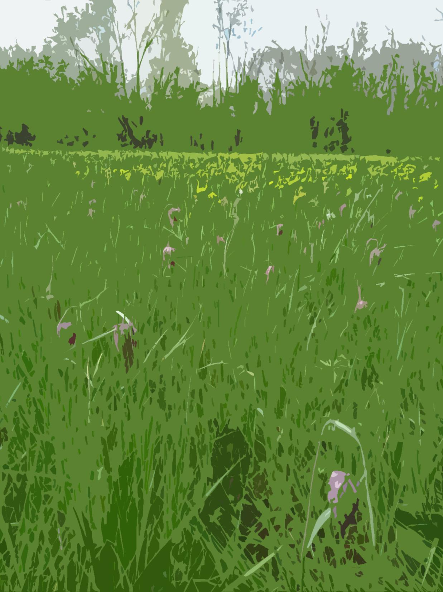
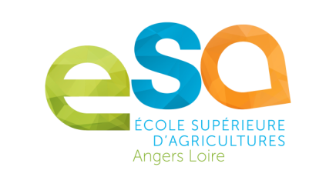
Basses vallées angevines Flood meadows of Angers
A French case study in high nature value farming
Josephine Pithon
Notes:
The aim of this short case study is to provide an insight into a specific High Nature Value farming system. Most HNV systems in France are in mountainous areas where high nature value grasslands are the basis for extensive production of quality meat and dairy products. This case study concerns a rather different, low-lying context of river valleys in the north-western part of the country.

Slide 2
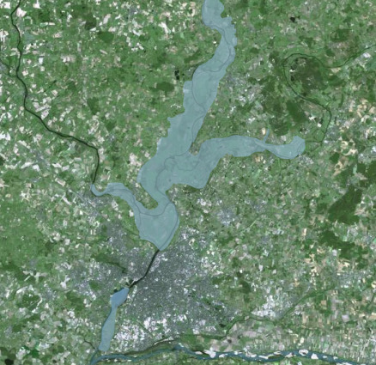
The largest confluence of the River Loire
Sarthe
Loir
Mayenne
RAMSAR SITE
Loire
© IGN 2017 - w w w.geoportail.gouv.fr/mentions-legales
Notes:
To the north of the town of Angers in western France, three rivers (Loir, Mayenne and Sarthe) join the river Maine, forming the largest confluence of the Loire River catchment.
This vast alluvial plain plays a key role during winter and spring flooding periods when it absorbs water which would otherwise lead to severe urban flooding. At such times 200 million cubic metres of water form a lake 30 km long and 5 km wide.
A large portion is recognised as a wetland of international importance under the Ramsar Convention.

Slide 3
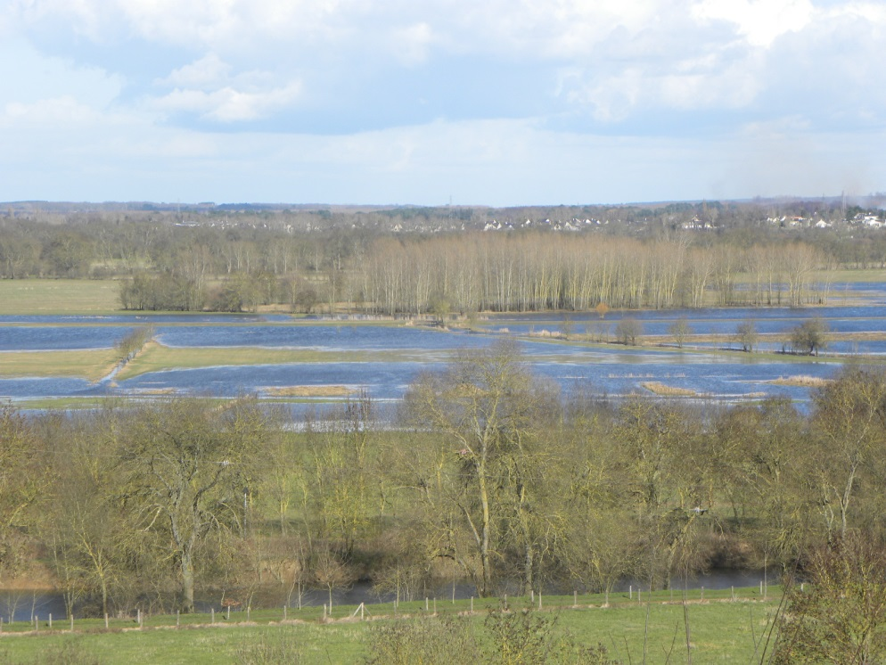
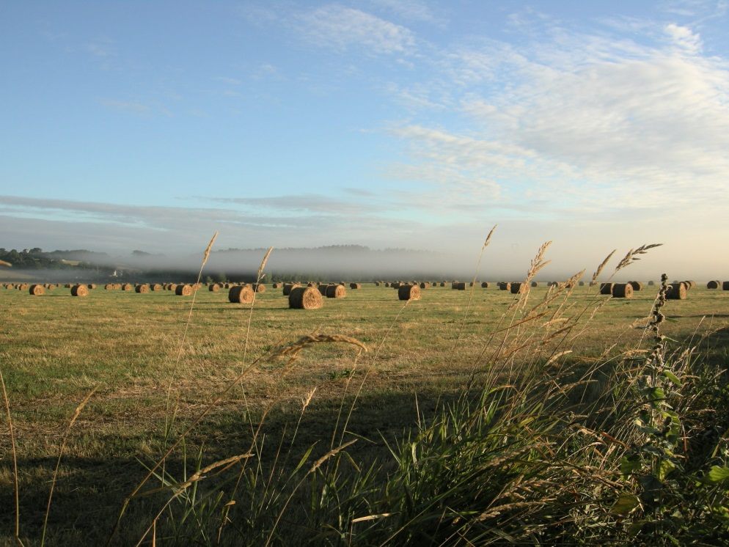
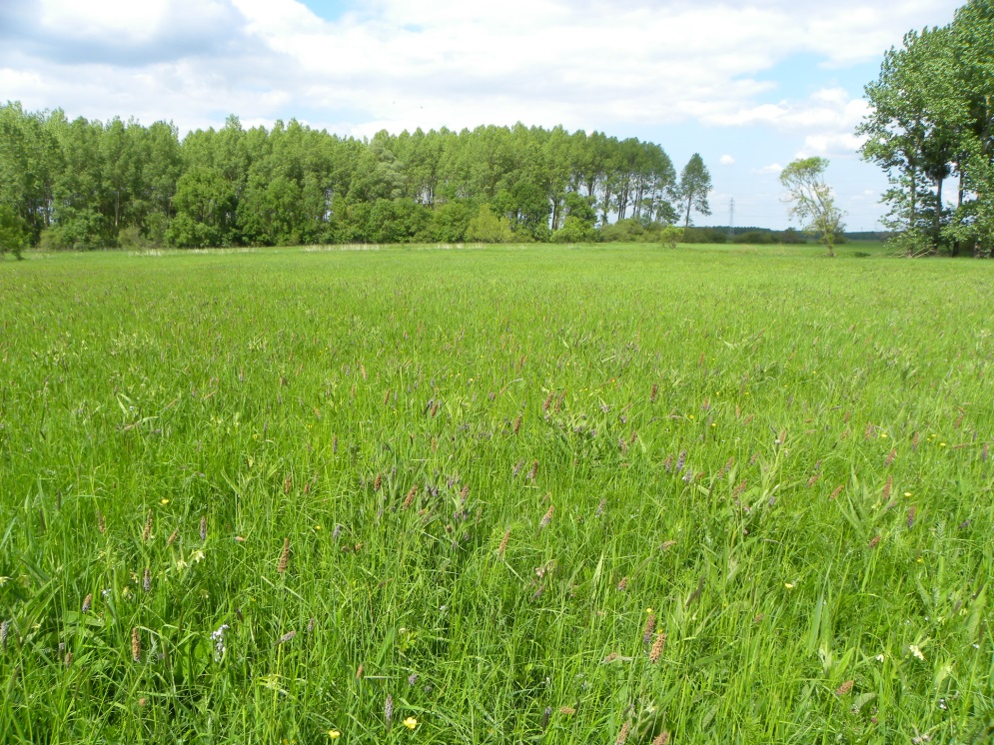
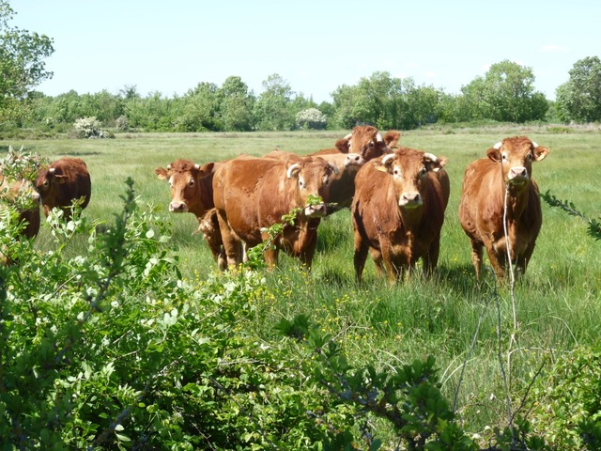
Extensively grazed or mowed since the Middle Ages
Flooded meadows in February E.Séchet
Haymaking in June / July E.Séchet
Poplar plantation and meadow E.Séchet
Limousine cattle J. Pithon
Notes:
The land was deforested by local people in the Middle Ages despite being waterlogged for much of the year. Through grazing and mowing, a landscape of meadows delineated by hedgerows and riverbank trees emerged. Ash, willow and alder were traditionally coppiced to produce wood for fuel and tool-making.
In more recent times, the area suffered from a period of land abandonment. With meadows under water for between 3 and 7 months of the year, profitable agriculture is difficult to achieve.
In place of the original alluvial forests that were cleared to make way for extensive livestock farming came poplar plantations. Within a few decades, around 1400 ha were converted to this land use, i.e. around 15% of the area.
In the 1990s, with financial help from the EU, local people brought in new measures to try to conserve extensive agriculture and the biodiversity associated with this form of land management.
The pictures illustrate the way the landscape looks these days. The livestock used in the area today are either Limousine or Charolaise cattle breeds.

Slide 4
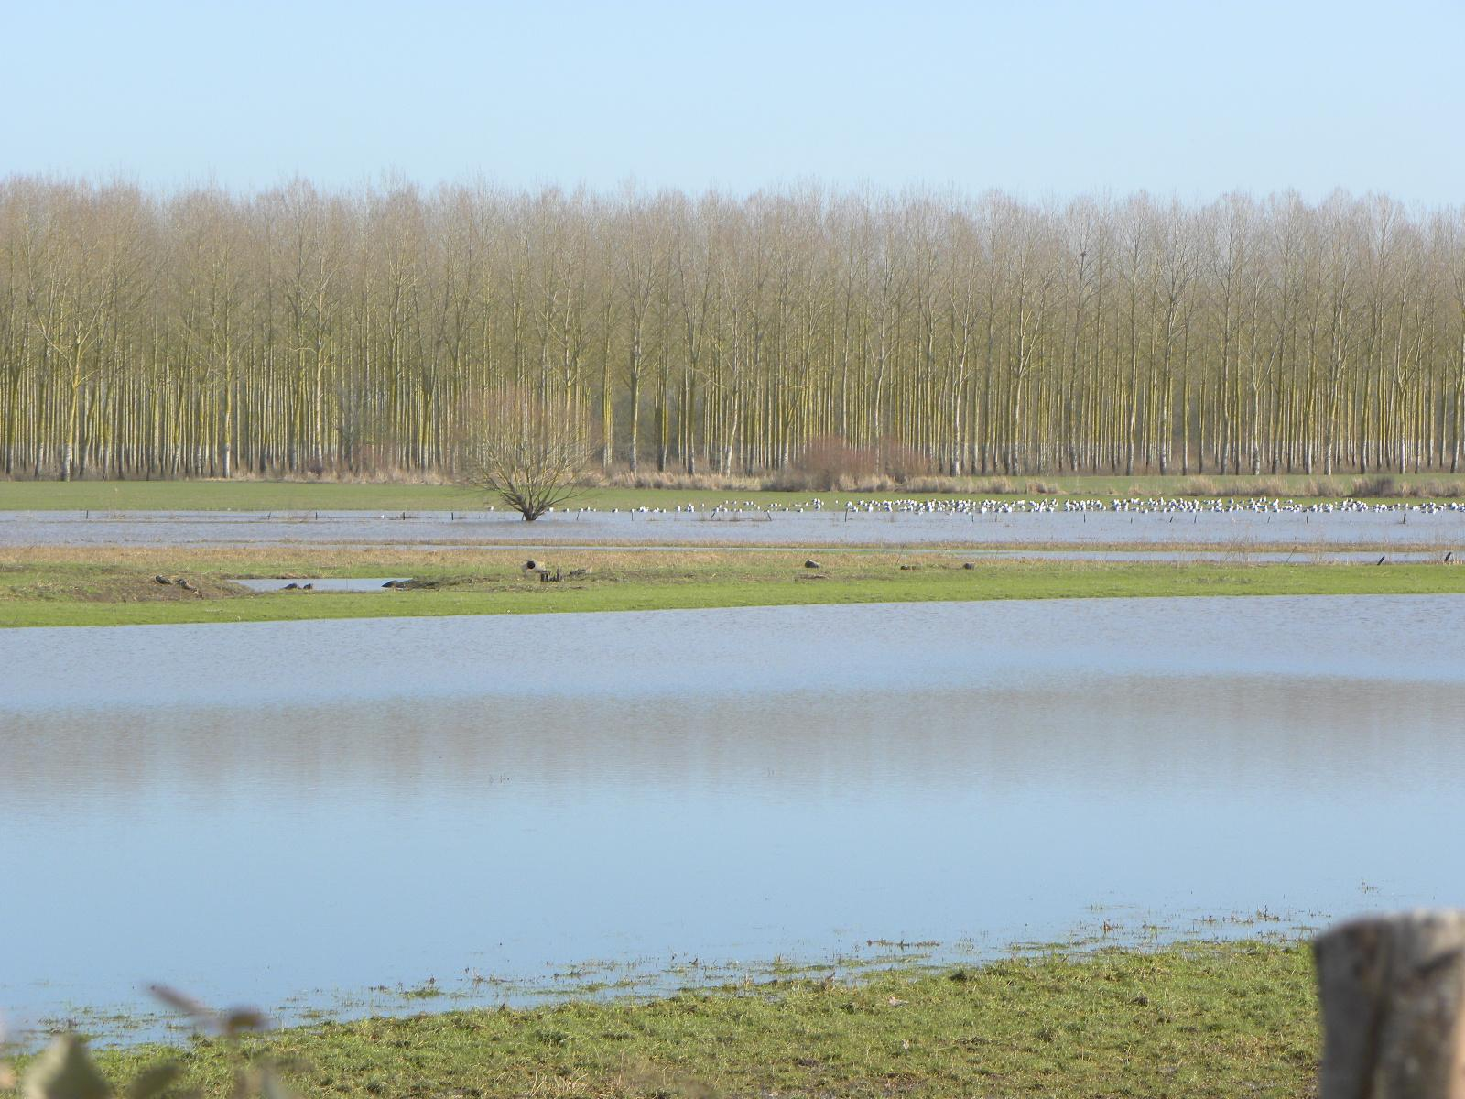
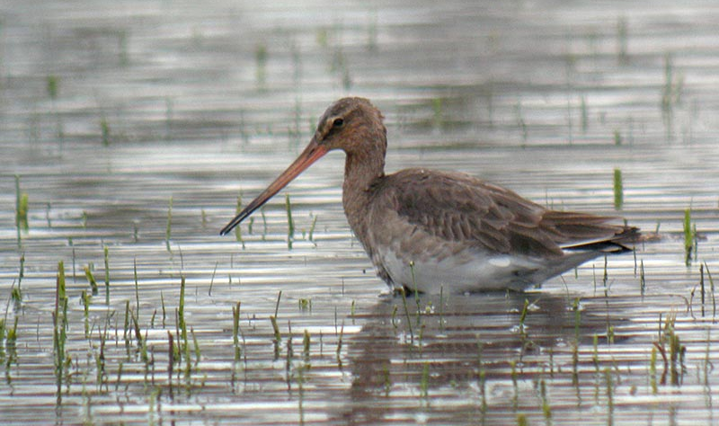
Nature conservation in the flood meadows
Winter and early spring
Waterbirds in the flooded meadows in late winter (February) E. Séchet
Black-tailed Godwit A. Fossé
Notes:
In mid-winter and early spring the flood waters provide valuable resting areas for migratory birds. Over 100,000 birds use the site during migration to feed, rest, and shelter from the cold.
In mid-winter the ducks: greylag Anser anser, pintail Anas acuta, Shoveler Anas clypeata…
In early spring Lapwing Vanellus vanellus and black-tailed godwit Limosa limosa, to name but a few.
15% of the western European population of black-tailed godwits (15-30000 individuals) pass through the site each year on their annual migration from west Africa to their breeding grounds in Holland or Iceland.

Slide 5
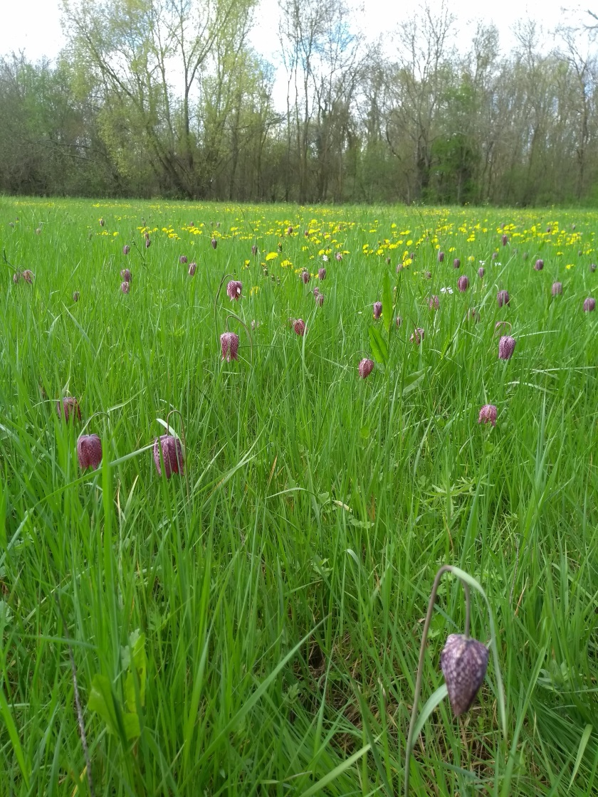
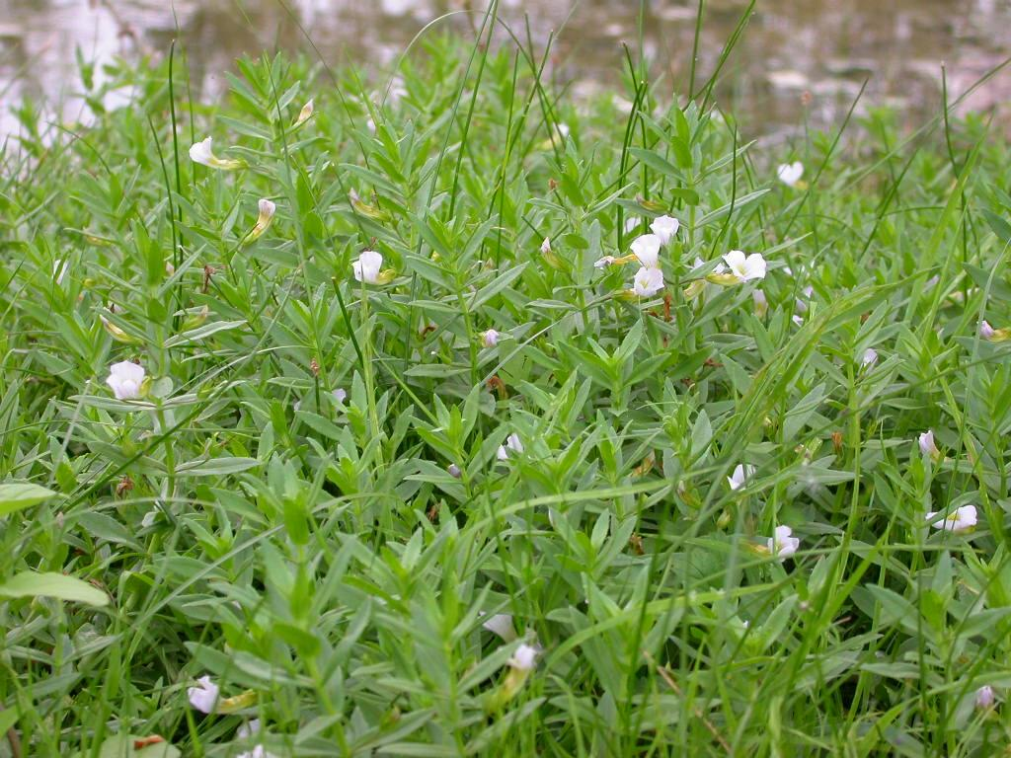
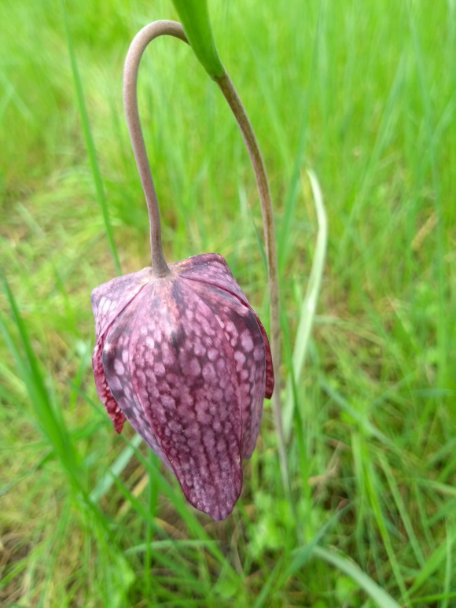
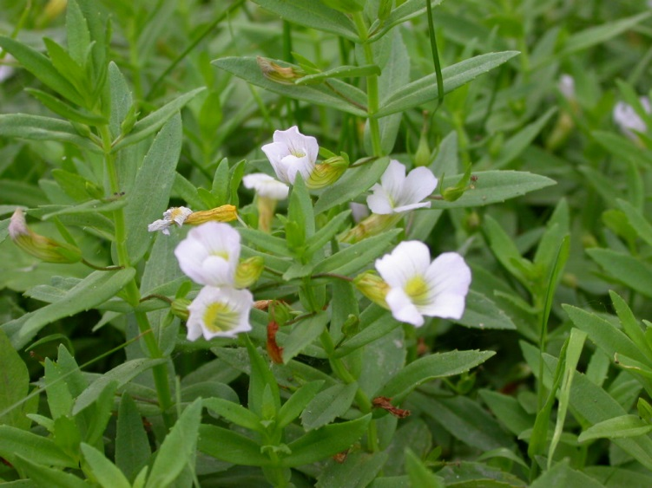
Nature conservation in the flood meadows
Late spring and summer
Snake’s head fritillaries flowering in April J. Pithon
Hedge hyssop flowering in July E. Séchet
Notes:
When the flood water recedes the meadows host a hugely diverse flora and fauna.
Noteworthy species of plants include the early flowering snake’s head fritillary Fritillaria meleagris (pictured), the hedge hyssop Gratiola officinalis (pictured), the meadow fleabane Inula brittanica and the small-flowered bittercress Cardamine parviflora.
Over 300 species of plant have been recorded in the meadows, thirty of which are protected at regional or national level.

Slide 6
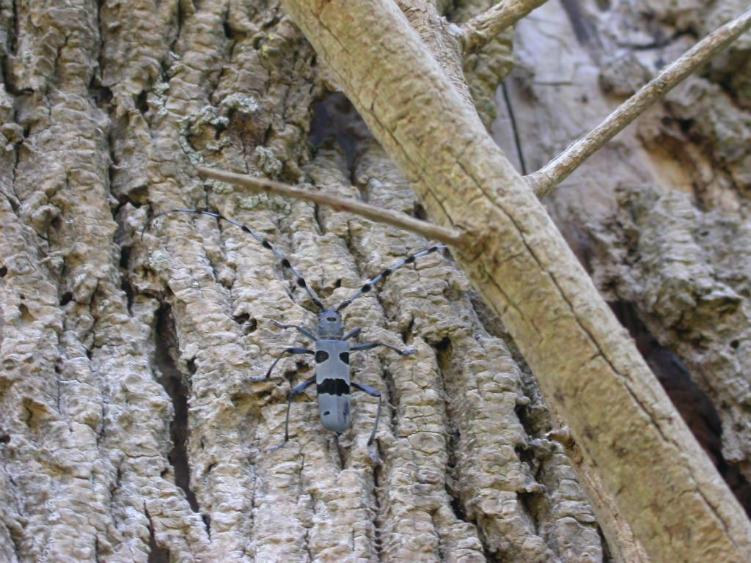
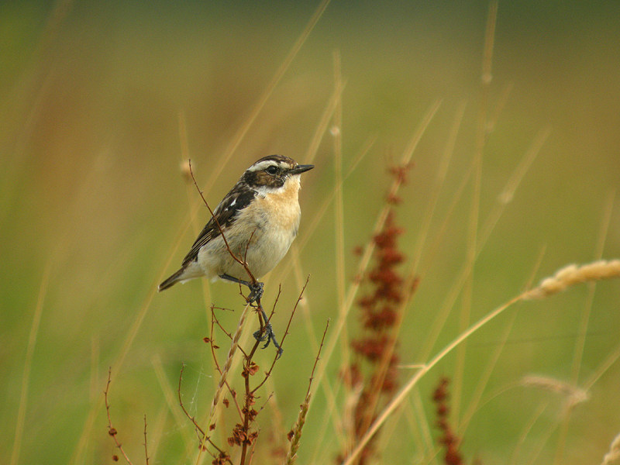
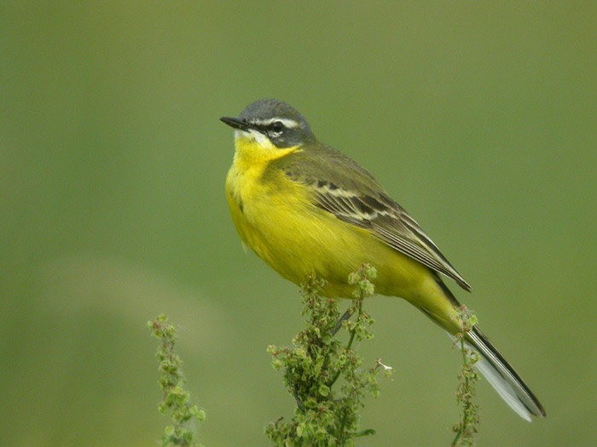
Nature conservation in the flood meadows
Late spring and summer
Whinchat and yellow wagtail (left): typical species of wet grassland in the breeding season A. Fossé
Longhorn beetles live in old ash trees traditionally coppiced for firewood production. E. Séchet
Notes:
A rich terrestrial and aquatic fauna include :
grassland invertebrates such as the large marsh grasshopper Stethophyma grossum
xylophage insects such as the longhorn beetle Rosalia alpina or giant capricorn beetle Cerambyx cerdo that live in the older hedgerow networks
Longhorn beetles depend on dead wood and live in old ash trees traditionally coppiced for firewood production.
fish species such as eel Anguilla anguilla or twaite shad Alosa fallax
meadow nesting bird species such as whinchat Saxicola rubetra and yellow wagtail Motacilla flava

Slide 7
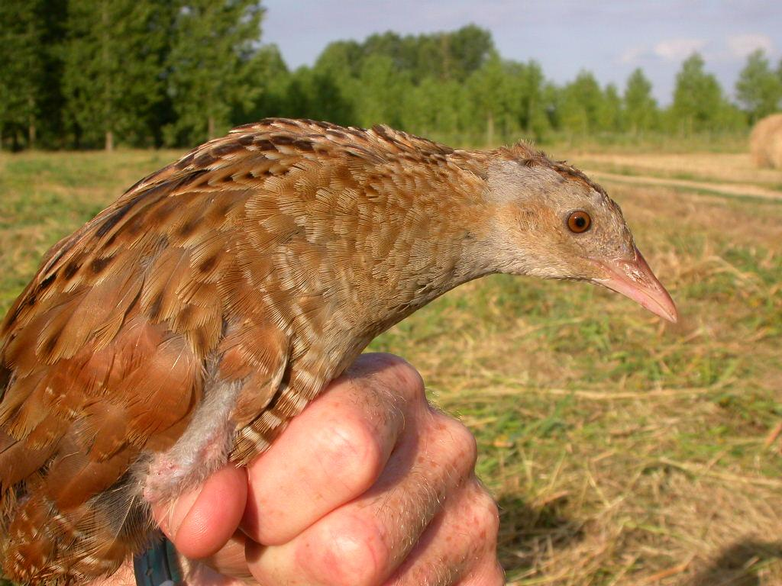
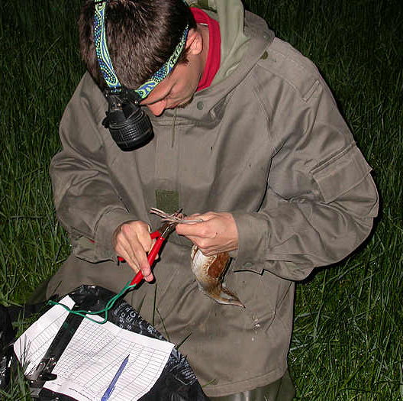
Corncrake Crex crex : « umbrella species ? »
Corncrake adult in the hand (left) E. Séchet
Ringing and measuring (below) A. Fossé
The corncrake population is closely monitored by annual counts of singing males.
Notes:
The most emblematic species of the area is the corncrake Crex crex.
This shy, skulking, ground-nesting bird breeds in western Europe and migrates to Africa in the winter. It nests in high grass and is vulnerable to early mowing which can destroy its nests before the young have fledged. It also relies on a rich invertebrate diet and is, therefore, absent from intensively farmed areas where pesticides destroy its food source.
It is considered to be an « umbrella species » as its presence is associated with a rich meadow flora and a diversity of other animal species.
However, a recent study has shown that other passerine species in the study zone may be better candidates cf. Fourcade, Besnard & Secondi (2017) Evaluating interspecific niche overlaps in environmental and geographic spaces to assess the value of umbrella species. Journal of Avian Biology.
Above all, as the French populations of this species are currently in steep decline, the Angers population represents by far the largest colony of singing males at national scale.
The corncrake population is closely monitored by annual counts of singing males. Mowing operations are attended by local bird protection groups in order to save fledglings. A ringing programme enables individual movements to be studied.

Slide 8
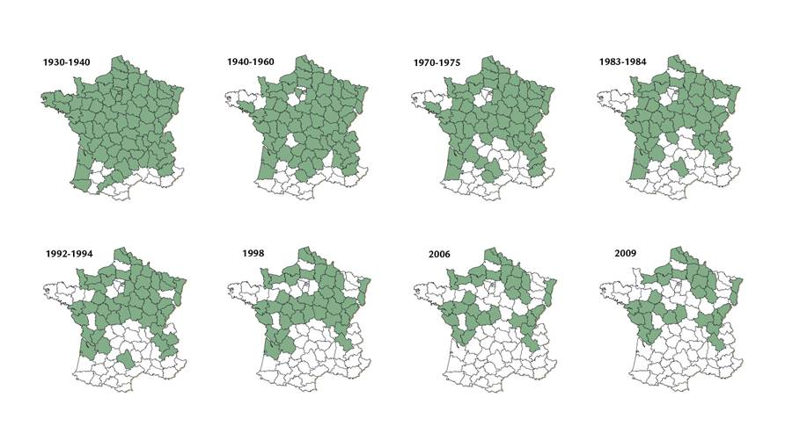
Decline in the number of singing male Corncrakes in France from 1930-1940 to 2009
Distribution of singing male Corncrakes in France, 2009
Source: Deceuninck B. (2011) Statut du Râle des genêts Crex crex en France en 2009. Distribution, effectifs et tendance Ornithos 18-1 : 11-19 (Reproduced with permission)
Notes:
These distribution maps speak for themselves and highlight the importance of the Angers flood meadows at national scale for this species.
Deceuninck B. (2011) Statut du Râle des genêts Crex crex en France en 2009. Distribution, effectifs et tendance Ornithos 18-1 : 11-19

Slide 9
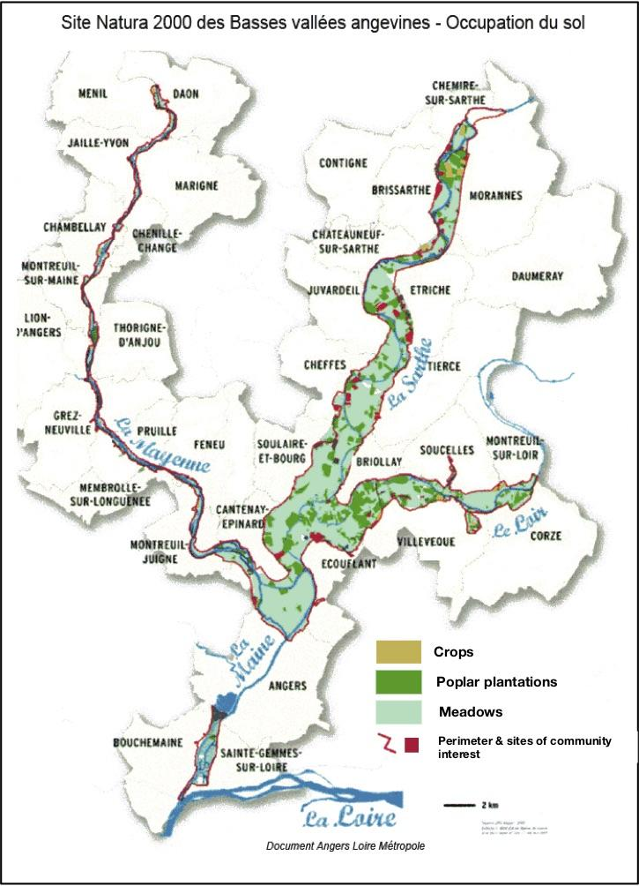
Agri-environment schemes and the Natura 2000 site
Extent of Natura 2000 area (in red) and the distribution of three land cover types
Notes:
In the 1990s, in response to the land management changes that threatened to compromise the balance between agricultural production and biodiversity, a number of local organisations began to look at ways to reverse the process of land abandonment and poplar afforestation.
The first agri-environment schemes, encouraging farmers to adopt more biodiversity-friendly grassland management practices, appeared in 1992.
The site was designated an SPA (Special Protection Area) and then a SAC (Special Area for Conservation) Under the terms of the EU « Birds » and « Habitats » Directives.
The first Natura 2000 Document of Objectives (Docob, 2004) was considered a successful compromise between potentially conflicting interests and is a relatively unique example of such a compromise in France.
This map shows the extent of the Natura 2000 site (in red) and the distribution of three land cover types : crops (brown), poplar plantations (dark green) and meadows (light green).

Slide 10
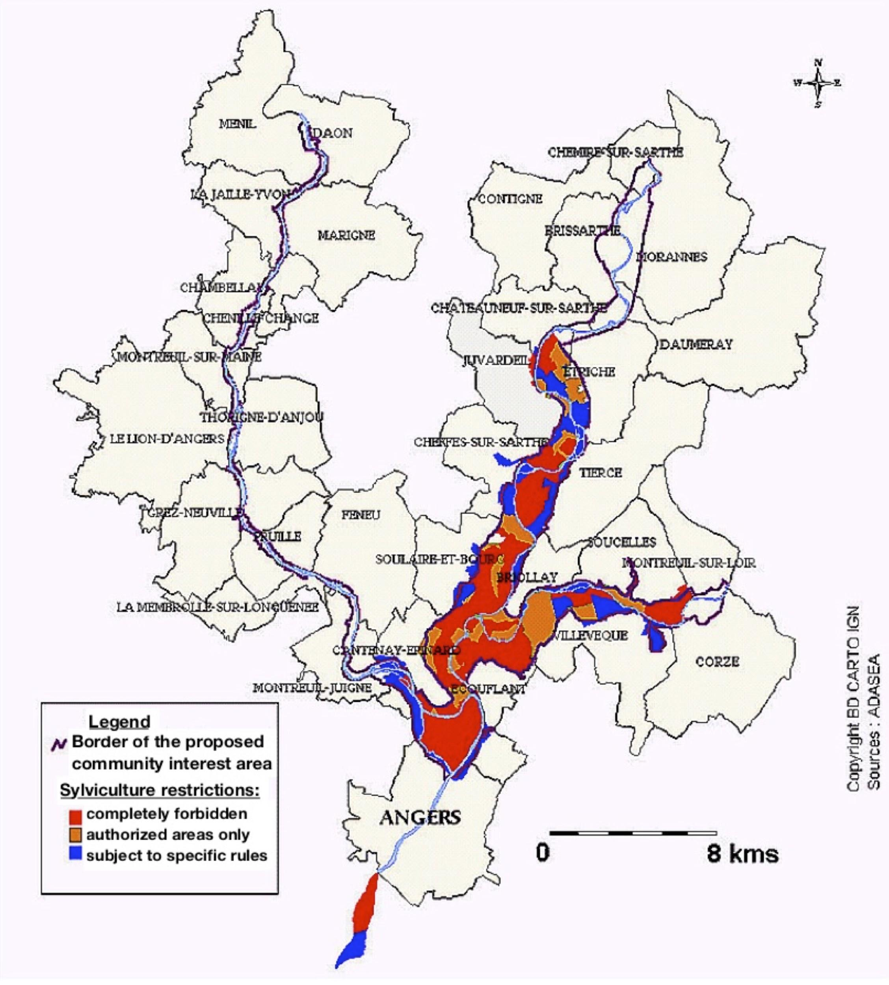
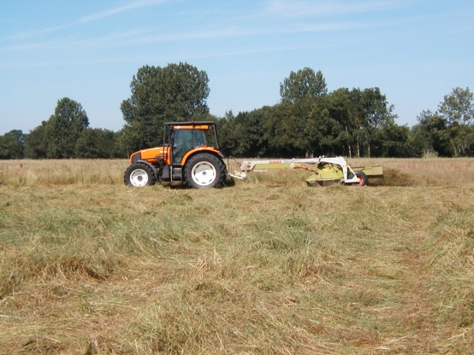
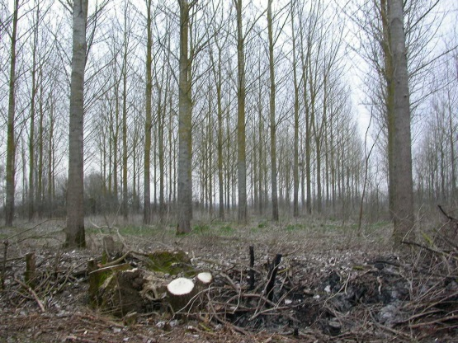
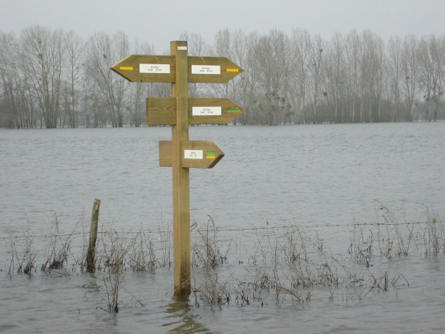
A successful Natura 2000 negotiation
Notes:
In France, Natura 2000 implementation is through contractual methods rather than being imposed by legislation as in some other EU Member States.
This means that all local interests in the protected area must meet and thrash out a management plan together, which makes allowances for these different interests while stating clear objectives for the conservation of wildlife « d’intérêt communautaire » (of community interest).
In the Angers flood meadows the interests of local residents, forestry, farming, hunting, fishing and nature conservation were represented when the management plan was negotiated. The discussions were led by an agricultural extension organisation (ADASEA).
Once the plan had been decided, implementation of changes to management and farming practices had to be via invitation to sign up for agri-environment schemes.
The map on the right shows one example of a compromise reached during the negotiations. The map indicates the areas in which sylviculture is completely forbidden (red), those where it is authorised (orange) and those where it is subject to certain rules (blue). SOURCE ADASEA Natura 2000 “Document d’Objectifs” http://www.angersloiremetropole.fr/fileadmin/plugin/tx_dcddownloads/docobBVAnatura2000.pdf

Slide 11
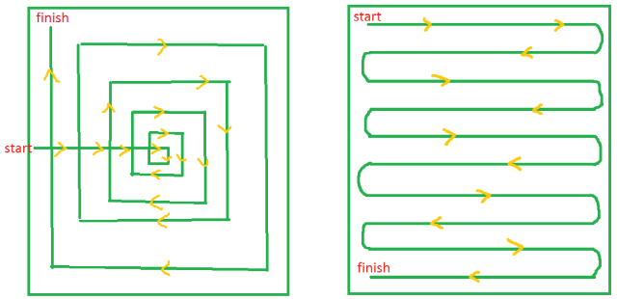
Support for wildlife-friendly management
through Agri-Environment Schemes (AES)
Maintenance of hedgerow networks
Preservation and maintenance of older trees and dead wood
Extensive grassland management
limited use of fertilizer
lower stocking rates
Wildlife-friendly mowing
later mowing dates
mowing from centre outwards (pictured)
Notes:
The Agri-Environment Schemes (AES) system has enabled farmers to adjust their management practices to the needs of wildlife.
Illustration source : http://www.farmbiodiversity.ca/helping-habitat-2/hayfield/hayfield-management-ideas/

Slide 12
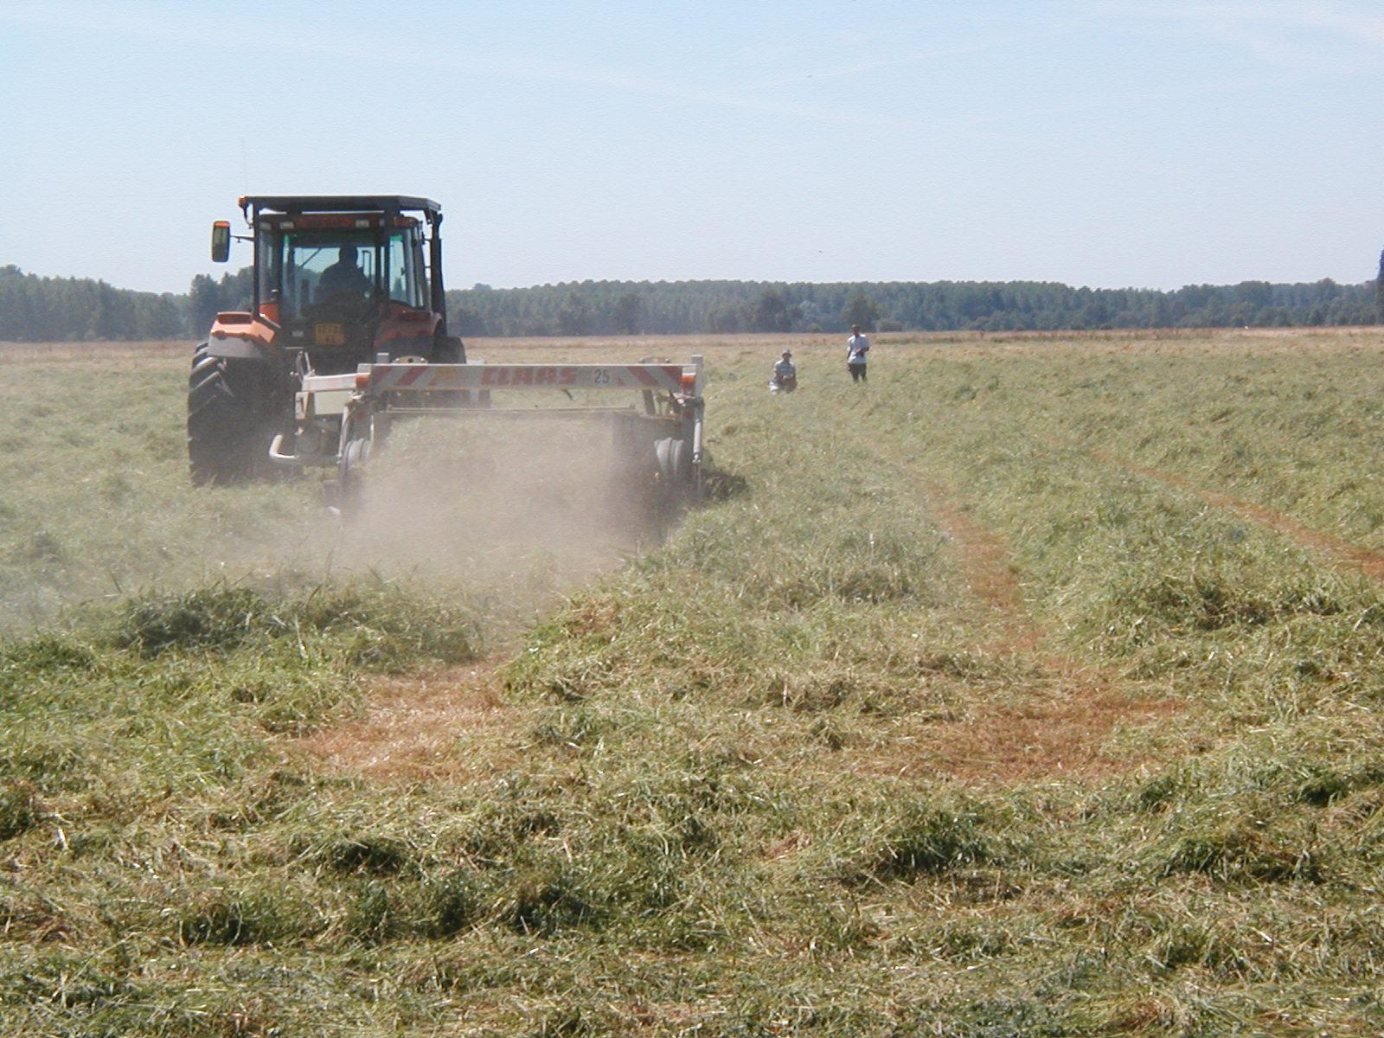
A series of changing Agri-Environment Schemes
Late mowing allows ground-nesting birds to finish breeding
1992 / OLAE
1999 / CTE
2002 / CAD
2007 / MAET
2014 / MAEC
E. Séchet
Notes:
With changing governments and successive CAP reforms, the French system for agri-environment schemes has been constantly evolving. This poses a number of problems for farmers depending on the type of financial aid:
There is a lot of administrative work involved and the criteria to meet are always changing ;
The schemes are signed for a period of 5 years (in other Member States agri-environment schemes sometimes run for longer) and so this work needs to be done at regular intervals and the farmer cannot be guaranteed support for long-term changes to his/her farming system ;
All of this leads to some farmers feeling uncomfortable about their dependence on this somewhat artificial financial support.

Slide 13
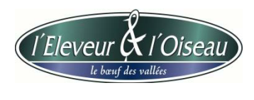
Local commercialisation and a labelling scheme
1997: Concerns about the future of livestock farming in the flood meadows
2001: “Angers Valleys Livestock Farmers Association” founded 2004: Registered trademark, publicity and promotion film made
2005: Difficulties in establishing regular production and sales
2008- - ?: Collaborative work between local wildlife protection association, agriculture extension services, farmers and meat sector
2018: 11 farmers, 6 sales points
The Farmers’ promise:
Conservation management of natural flood meadows;
Feed livestock on grass/hay;
Practice extensive agriculture & respect animals’ well-being ;
Practice wildlife friendly mowing
Refrain from using pesticides in the flood meadows
Notes:
Billaudeau, Valérie & Thareau, Bertille. (2010). « L'éleveur et l'oiseau » : rayonnement d'une démarche agro-environnementale innovante. Marché et organisations. 11. 155. 10.3917/maorg.011.0155.
In 1997, the uncertainty surrounding AES became unacceptable for many local farmers. This, along with the state of the meat market in the wake of the 1996 mad cow disease crisis, led them to work together to establish a local market for meat produced in the valleys.
In 2001 the « Association des Eleveurs des Vallées Angevines » (Angers Valleys Livestock Farmers Association) was formed. It took three years until, in 2004, the new label came into operation in collaboration with a local supermarket’s butcher.
The label «L’Eleveur et l’Oiseau » (The Farmer and the Bird) chose the Corncrake as its symbol.
But the farmers struggled to produce enough meat and of sufficient quality and by 2005 the commercialisation was almost non-existent.
Since 2008 farmers have continued to try to boost the Association, the involvement of its members, the sales of meat with some success. But the agri-environmental management still depends on EU funds.
See also http://leleveuretloiseau.wixsite.com/boeuf49
1997: Concerns about the future of livestock farming in the flood meadows
2001: « Angers Valleys Livestock Farmers Association » founded to promote local sales of « wildlife friendly meat »
2004: Registered trademark and local commercialisation circuit in place, publicity and promotion film made
2005: Difficulties in establishing regular production and sales,
2008- - ?: Collaborative work between local wildlife protection association, agriculture extension services, farmers and the meat sector
2018: 11 farmers, 6 sales points in the local area, farmers continue to depend on AES
The farmers’ promises:
To preserve natural flood meadows with appropriate management ;
To feed our stock on grass or hay throughout their lives ;
To practise extensive agriculture and to respect our animals’ well-being ;
To contribute to the conservation of the Corncrake and meadow fauna in particular through wildlife friendly mowing and by not using pesticides in the flood meadows

Slide 14
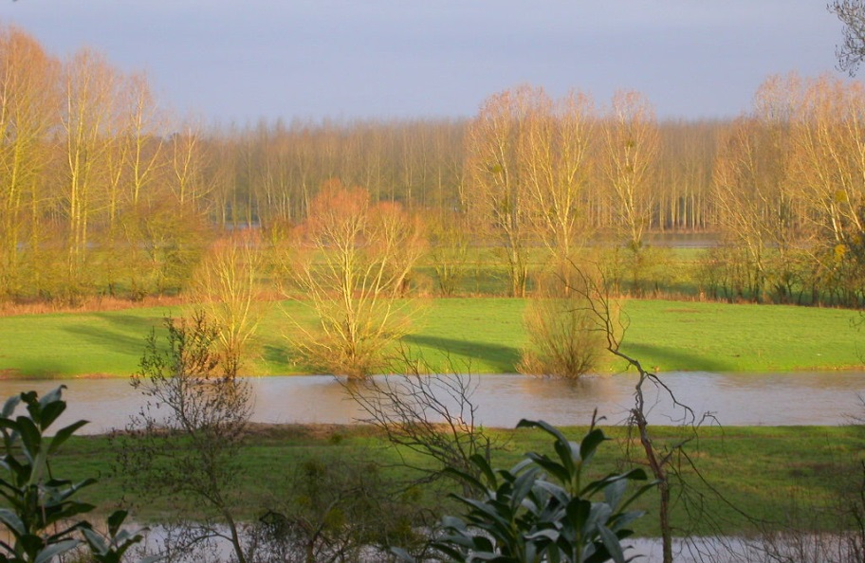
Successes of this flood meadow farming system
Natura 2000 provides a good general protection framework, supported by the Agri-Environment Schemes;
Flood meadows maintain high levels of biodiversity including declining or threatened species;
“Angers Valleys Livestock Farmers Association” continues to promote their wildlife-friendly agriculture and products;
A new film (in French) made by the local BirdLife International partner (LPO) describes the current state of affairs.
E.Séchet
Notes:
Natura 2000 provides a good general protection framework and since 2008 France has put in place laws making environmental impact assessment obligatory before any major modifications to habitat ;
Although wildlife monitoring is patchy, the flood meadows still attract and maintain high levels of biodiversity including declining or threatened species. Recently local ornithologists counted the largest lowland population of Whinchat in France ;
The « Angers Valleys Livestock Farmers Association » continues to promote their wildlife-friendly agriculture and meat products, inviting local people and tourists to participate in annual « Evening walk and barbecue » events
A new film (in French) made by the local BirdLife International partner (LPO) describes the current state of affairs in positive terms :
https://drive.google.com/file/d/1DPL6AOHVml9Jc9yc0DgGRssgpSL974up/view?usp=sharing

Slide 15
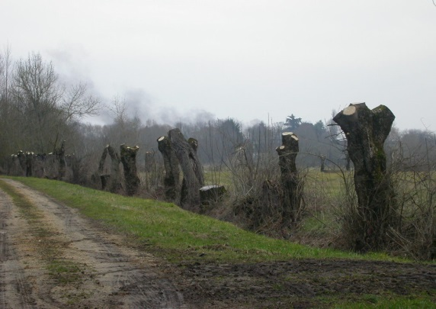
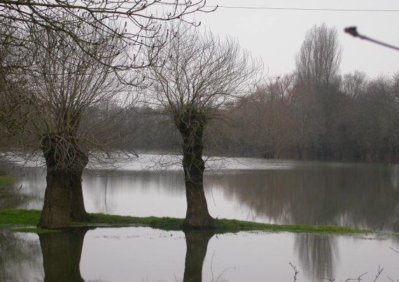
Remaining challenges in the flood meadows
Is agri-environmental action truly effective for biodiversity enhancement ?
How can AES’s fixed mowing dates be staggered to avoid large areas being disturbed simultaneously?
How can wood from hedgerows be exploited?
How can aging trees and hedgerows be replaced?
How can clear-cut poplar stands be effectively converted back to semi-natural grassland?
How can farmer dependency on on EU payments be reduced?
How can younger farmers be persuaded to invest in these challenging floodlands?
Old ash trees, traditionally coppiced for firewood
E. Séchet
Notes:
At a recent steering committee held during the process of renewing the Natura 2000 management plan, the following key challenges were listed by locally involved parties :
The effectiveness of agri-environmental action is not always demonstrated. Corncrake populations have tended to decline nationally and the positive effects of action at local scale are difficult to assess;
The AES fixed mowing dates lead to large areas of grassland being mown on the same day, which poses a threat to fauna seeking refuge from the mowing machines;
Hedgerow networks are being maintained but the question of how to exploit their wood and of how to renew aging trees and hedges remain to be answered in the coming years;
As poplar plantations lose their popularity the question of how to effectively convert this land back to high nature value grassland is prominent;
Currently, AES payments are delayed and many farmers are awaiting compensation payments for agri-environmental action. They remain highly dependent on this form of artificial support and uncertain about the economic future of «farming for biodiversity»;
Many of the farmers in the area are reaching retirement, so there is the difficult question of how to interest a younger generation in farming in these challenging areas.
Challenges
Is agri-environmental action truly effective for biodiversity enhancement ?
How can AES fixed mowing dates be staggered to avoid large areas being disturbed simultaneously ?
How can wood from hedgerows be exploited ?
How can aging trees and hedgerows be replaced ?
How can clear felled poplar stands be effectively converted back to semi-natural grassland ?
How can farmers depend less on EU payments ?
How can younger farmers be persuaded to invest in these challenging floodable lands ?

Slide 16
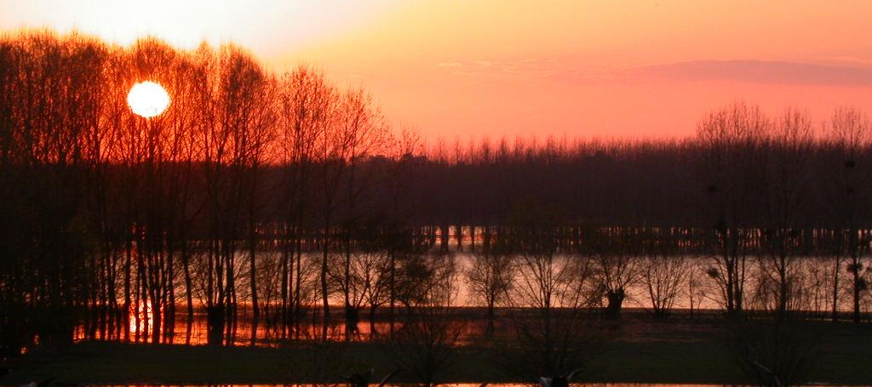
The Angers case illustrates HNV farmland issues
Angers are HNV farmlands that exist because they are difficult to farm intensively.
Farming for biodiversity/nature values is a possible sustainable livelihood strategy in this context.
Ongoing management requires outside financial support for the environmental services farmers provide.
Farmers seek more autonomy and the development of local food systems, food labelling schemes, direct sales etc.
E.Séchet
Notes:
This HNV system, like many others, exists in part because the land is difficult to exploit in agricultural terms and more intensive forms of agriculture difficult to implement. Farming for wildlife becomes a possible pathway to sustainability in this context, provided farmers can be supported in their contribution to environmental preservation (through AES in EU Member States). This reliance on external financial support leads farmers to explore methods for increased autonomy. One way is to add value to their products is by developing local sales points, biodiversity labelling schemes and other forms of direct sales and marketing.
For discussion: Could a HNV system function in other types of context? Are the characteristics described here present in all HNV farmlands, or are there also examples of farmers valuing nature by choice in areas where more intensive agriculture would be possible?

Slide 17
Resources and experts
Research on biodiversity (in particular breeding birds) in the Angers Flood Meadows, published in English:
Fourcade Y., Besnard A.G., Secondi J. 2017. Evaluating interspecific niche overlaps in environmental and geographic spaces to assess the value of umbrella species. Journal of Avian Biology. DOI: 10.1111/jav.01153
Besnard A.G., Fourcade Y., Secondi J. 2016 Measuring difference in edge avoidance in grassland birds: the Corncrake is less sensitive to hedgerow proximity than passerines. Journal of Ornithology, 157: 515-523.
Besnard A.G., Secondi J. 2014 Hedgerows diminish the value of meadows for grassland birds: Potential conflicts for agri-environment schemes. Agriculture Ecosystems & Environment 189, 21-27.
Publications in French :
Billaudeau, Valérie & Thareau, Bertille. (2010). « L'éleveur et l'oiseau » : rayonnement d'une démarche agro-environnementale innovante. Marché et organisations. 11. 155. 10.3917/maorg.011.0155.
Deceuninck B. (2011) Statut du Râle des genêts Crex crex en France en 2009. Distribution, effectifs et tendance Ornithos 18-1 : 11-19
Experts
Joséphine PITHON j.pithon@groupe-esa.com
E.Séchet

Slide 18
Resources and experts
Local websites
The local farmers’ website http://leleveuretloiseau.wixsite.com/boeuf49
The local BirdLife International partner website (LPO Anjou) http://www.lpo-anjou.org/lpo-anjou/sites-especes/
Experts
Joséphine Pithon j.pithon@groupe-esa.com
E.Séchet

Slide 19
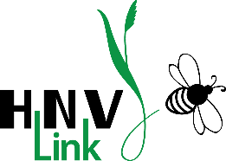
This presentation, produced by Joséphine Pithon at ESA Angers (http://www.groupe-esa.com/), has been provided for HNV-Link project to be included into the educational package on High Nature Value farming. Other resources of the education package are available www.hnvlink.eu.
It is an Open Source material under CC BY-NC-SA. You may use freely any elements of it or as a whole, also modifying as fit, as long as you cite the project and its funding and use is for non-commercial purposes.
Copyrights: all photographs courtesy of Emmanuel Séchet, Alain Fossé and Josephine Pithon unless otherwise indicated.
THIS PROJECT HAS RECEIVED FUNDING FROM THE EUROPEAN UNION HORIZON 2020
RESEARCH AND INNOVATION PROGRAMME UNDER GRANT AGREEMENT NO. 696391

